Slide 1
Application Management using DirectFB and ilixi Compositor
Takanari Hayama (IGEL Co.,Ltd./DirectFB integrated media GmbH)
Denis Oliver Kropp (DirectFB integrated media GmbH)
Hisao Munakata (Renesas Solutions Corp)

Slide 2
Objectives
“Lightweight Application Management Framework”
  Support existing software assets where possible.
    No need to modify existing assets to run on the new framework.
  Intuitive interface.
  Make the best use of available hardware accelerations.
  Small footprint.

Slide 3
Demo Video
Demo video

Slide 4
Demo Environment
Software:
  DirectFB 1.7.0 pre-release
    System driver for R-CarH1/E1
    Graphics driver for OpenGL/ES 2.0.
  ilixi
  Linux Kernel 3.4.10/2.6.35.9
Hardawre:
  Renesas R-CarH1
    CPU: ARM CoretexA9 Quad-core (1GHz)
    RAM: DDR3 1GiB
    GPU: PowerVR SGX543MP2

Slide 5
Architecture Overview
Sound Mixer
DirectFB
Application
WebKit
Home Screen
ilixi Compositor
(App Mgr)
Ilixi components
Status Bar
On Screen
Keyboard
DirectFB components
Other components
LiTE
(UI Toolkit)
ilixi
(UI Toolkit)
SaWMan
(Window Mgr
Framework)
DirectFB
(Grahpics Middleware)
FusionDale
(Service Manager)
FusionSound
(Audio Manager)
fusion
(IPC)
One
(IPC)

Slide 6

What is DirectFB?
Lightweight graphics middleware.
  Small footprint (< 1.5MB core for ARM in version 1.7.0)
  Not a server/client architecture like X11.
  Licensed under LGPL.
Supported features:
  Graphics rendering with hardware acceleration.
    All rendering primitives have software fallbacks.
  Optimized software rendering.
    Multi-core support.
    NEON/MMX support.
  OpenGL/ES2 support.
  Multi-process, multi-layer, input handling, windowing etc.
  Qt integration available.

Slide 7
Key Components
DirectFB Core
  Graphic renderings
  Input managements
  Frame buffer managements
  Graphics hardware managements
Fusion, One, FusionDale
  IPC mechanism
SaWMan
  Application Management Framework

Slide 8
DirectFB Architecture
DirectFB Core
gfxdrivers
(H/W Renderer)
GeneFx
(S/W Renderer)
systems
(H/W Manager)
input drivers
(key, touch, etc.)
video/image providers
(Decoders)
surface pools
(Resource Manager)

Slide 9
Screen, Layer, Window, and Surface
App
Window
Layers (H/W Specific)
Surface
WM
Layer 0
Surface
App
Window
Surface
Windows
Composition by
a Window Manager
Layer
Composition by
Hardware
Layer 1
Screen
(LCD etc)
Surface
Surface
:
Blit
App
Layer N
Surface
Application may get exclusive access
to a layer.

Slide 10
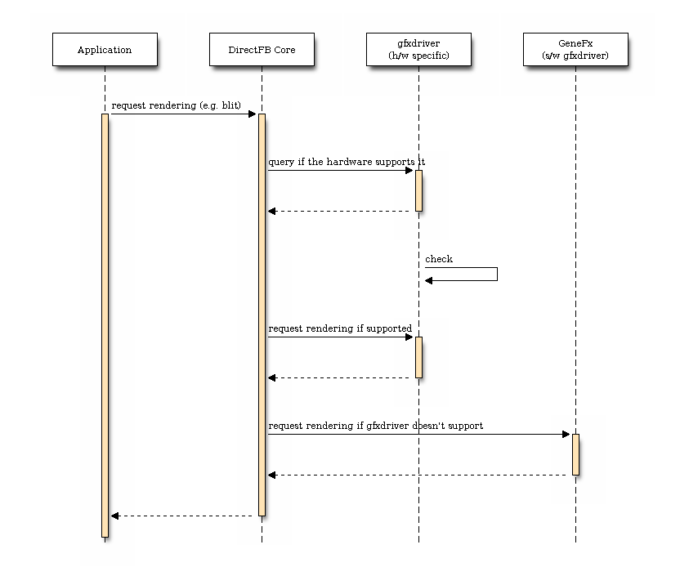
Rendering in DirectFB

Slide 11
SaWMan
“Shared Application and Window Manager”
  Co-developed by Royal Philips and Denis.
SaWMan provides application management framework.
  ilixi Compositor runs as an application manager in our scenario.
Application manager can hook into requests made by each application, and override configurations such as the size of windows.

Slide 12
What is ilixi?
A lightweight user interface toolkit for DirectFB
  Developed by Tarik Sekmen.
  Aims for rich graphical application for embedded Linux system.
  Small footprint (~512KB for ARM).
  Licensed under LGPLv3.

Slide 13
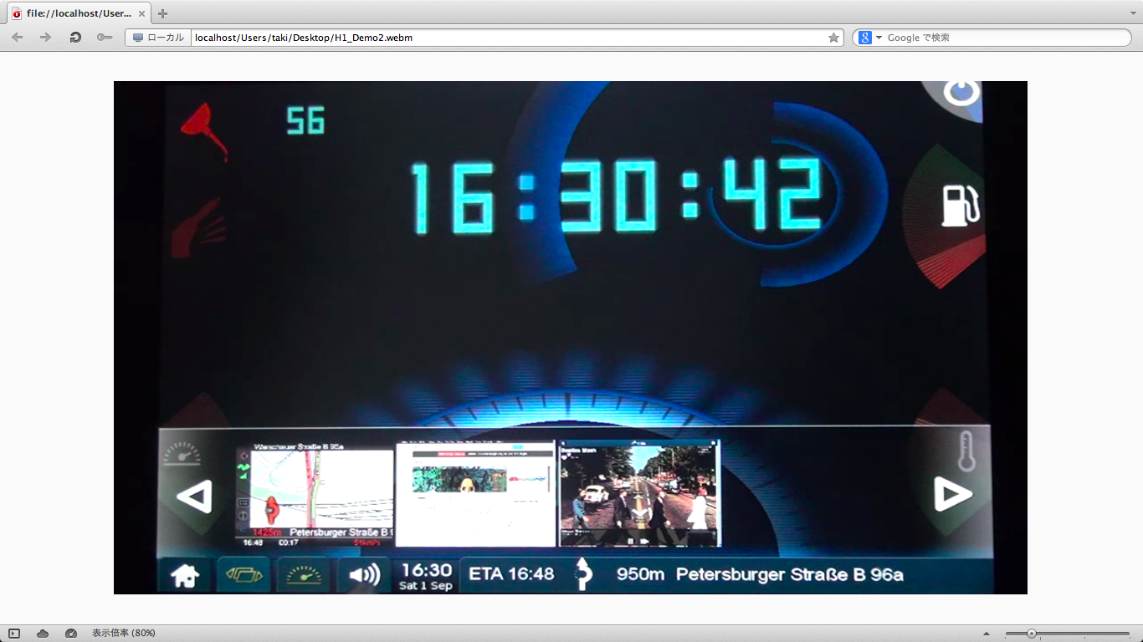
Components in ilixi

Slide 14
Components in ilixi (contd.)
Foreground Application
ilixi compositor
Background App
Background App
Background App
Status Bar

Slide 15
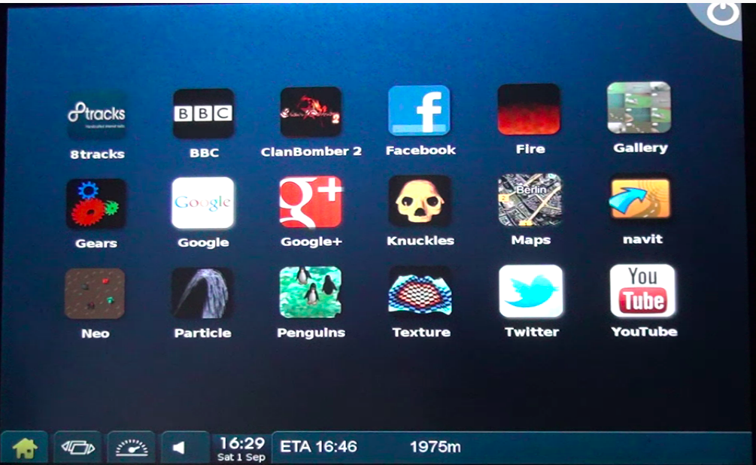
Components in ilixi (contd.)

Slide 16
Components in ilixi (contd.)
Home Application
Status Bar

Slide 17
Key ilixi Components in the Demo
Compositor
(ilixi_comp)
Application Launcher
(ilixi_home)
Status Bar
(ilixi_statusbar)
Ilixi Toolkit
FusionDale
DirectFB
Graphical User Interface
Inter-Components Interactions
On-Screen Keybard
(ilixi_osk)
Sound Mixe
(ilixi_mixer)

Slide 18
FusionDale
FusionDale is a service manager built on top DirectFB IPC mechanisms Fusion and One.
Servers registers methods and notifications as a component, a unit of service, to Component Manager (COMA).
Clients query COMA to subscribe to a service they need, and call methods and/or listen to notifications.

Slide 19
ilixi Compositor – ilixi_comp
Application Manager developed on top of ilixi toolkit and SaWMan.
  Application launcher
  Task switcher
ilixi Compositor treats all applications as its widgets.
  Applications may consist of multiple widgets.
  Requires ‘App Definition’ for each application.
Multiple widgets can be shown at the same time, i.e. multiple applications can be displayed as well.

Slide 20
ilixi Compositor
notification -
window added
SaWMan
Compositor
creates a window
AppCompositor #1
Application #1
SurfaceView
IDirectFBWindow
SurfaceView
IDirectFBWindow
sends window events
surface update event
flips surface
DirectFB
  Quoted from http://ilixi.org/docs/what_is_ilixi.pdf

Slide 21
App Definition Example
<?xml version="1.0"?>
<!DOCTYPE app PUBLIC "-//ilixi//DTD AppDef v1//EN" "http://www.ilixi.org/dtd/application.dtd">
<app>
<name>OnScreenKeyboard</name>
<author>Tarik Sekmen</author>
<licence>LGPL</licence>
<category>System</category>
<version>1.0</version>
<icon></icon>
<exec>ilixi_osk</exec>
<args></args>
<flags>APP_OSK, APP_SYSTEM</flags>
<deps>DEP_MOUSE</deps>
</app>

Slide 22
Application Flags
Application Type Flag | Description
APP_NO_MAINWINDOW | Application uses a surface instead.
APP_SPLASH_WINDOW | Application has a splash window.
APP_ALLOW_WINDOW_CONFIG | Application can modify its windows.
APP_SURFACE_DONTBLOCK | Application is not blocked when hidden.
APP_ALLOW_MULTIPLE | Application can have multiple instances.
APP_NEEDS_CLEAR | Background will be cleared with each update.
APP_NEEDS_BLENDING | AppCompositors will set blending mode for each SurfaceView.
APP_AUTO_START | Starts application when compositor is initialised.
APP_USE_BACK | Application can use a Back button.
APP_STATUSBAR | Statusbar application.
APP_OSK | On Screen Keyboard (OSK) application.
APP_HOME | Home application.
APP_SYSTEM | System application (not shown on home).

Slide 23
Home App – ilixi_home
Launches registered applications via ilixi Compositor.
  A list of registered apps is retrieved from the compositor.
  Requests ilixi Compositor to launch applications.
Replaceable with your one.
  Sample code is approximately 700 lines of codes!

Slide 24
Status Bar – ilixi_statusbar
Composes information from other apps such as Navit, sound mixer etc.
Surface from Navit is passed to Status Bar.

Slide 25
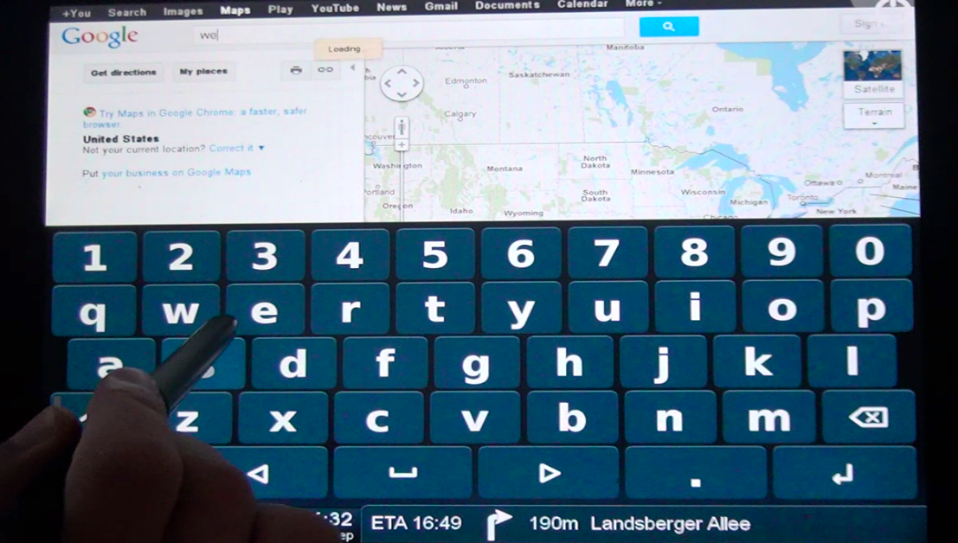
OSK – ilixi_osk

Slide 26
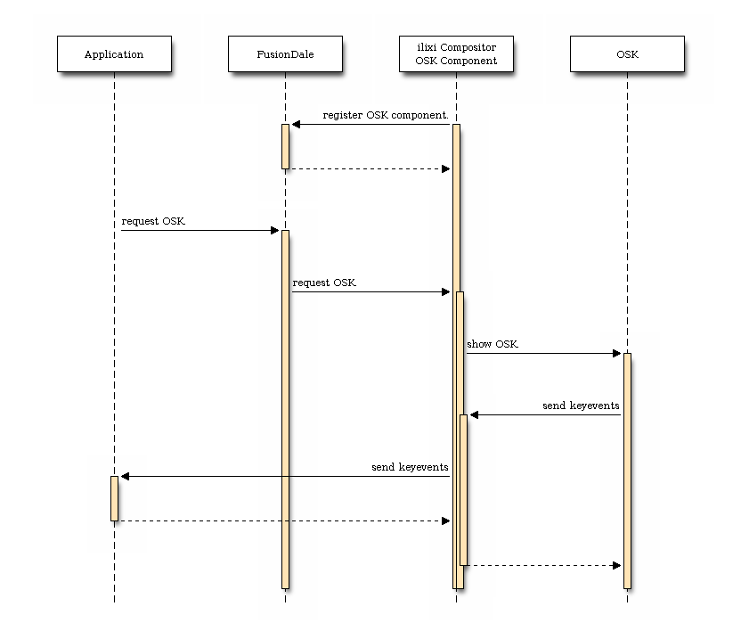
On Screen Keyboard

Slide 27
WebKit on DirectFB
WebKit directly runs on top of DirectFB
  LiTE toolkit is used for now.
  ilixi toolkit support is on its way.
  OSK is in ilixi Compositor.
Code is available at:
  git://git.directfb.org/git/directfb/libs/WebKitDFB.git
WebKit
ilixi
Compositor
ilixi_osk
LiTE
(UI Toolkit)
FusionDale
FusionSound
(for Sound)
ilixi
(UI Toolkit)
DirectFB

Slide 28
References
DirectFB
  http://www.directfb.org/
ilixi
  http://ilixi.org/
  http://ilixi.org/docs/what_is_ilixi.pdf

Slide 29
Acknowledgements
People who made this demo:
  Tarik Sekman (Author of ilixi)
  Andreas Shimokawa (DirectFB contributor)
  Marek Pikarski (DirectFB contributor)

