Slide 1
Upstream Linux Development

Slide 2
Outline
Statistics of Linux development
Renesas connection to the upstream
LTSI : Long Term kernel support initiative
Resolution of past Android isolation issue
Runtime PM (Power Management) update
ARM Linux updates
Conclusion

Slide 3
[ prologue ] Statistics of Linux development
Renesas has been major contributor to the Linux and other opensource (=OSS) upstream development. For this reason we believe we can provide the best solution to utilize latest opensource resources to make competitive consumer product with the most advanced SoC.

Slide 4
Linux is good, but so different from RTOS
RTOS | Linux
deterministic | heuristics
static | dynamic
fixed resource allocation | flexible resource allocation
predictable behavior | runtime coordination
real address space | virtual address space
single point development | distributed development
So it worth spending sometime for understanding “Linux” first.

Slide 5

We celebrated 20th year anniversary in 2011
Development statistics
  code size
  release interval
  developer size
Development process
Code Management system
kernel flexibility

Slide 6
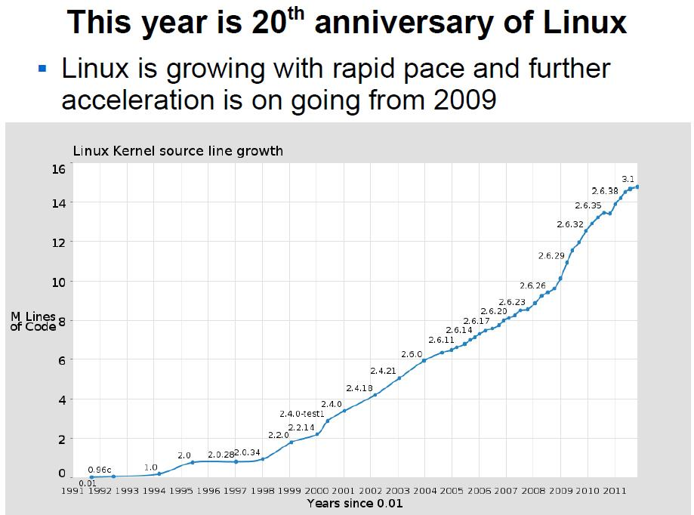
Kernel code line number trends [long term]
innovation
innovation

Slide 7
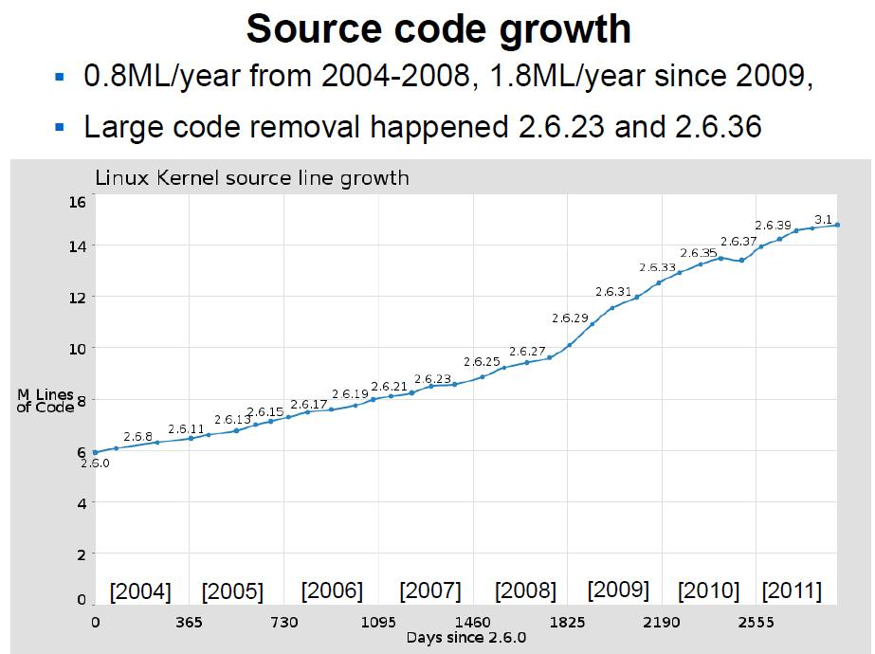
Kernel code line number trends [recent]

Slide 8
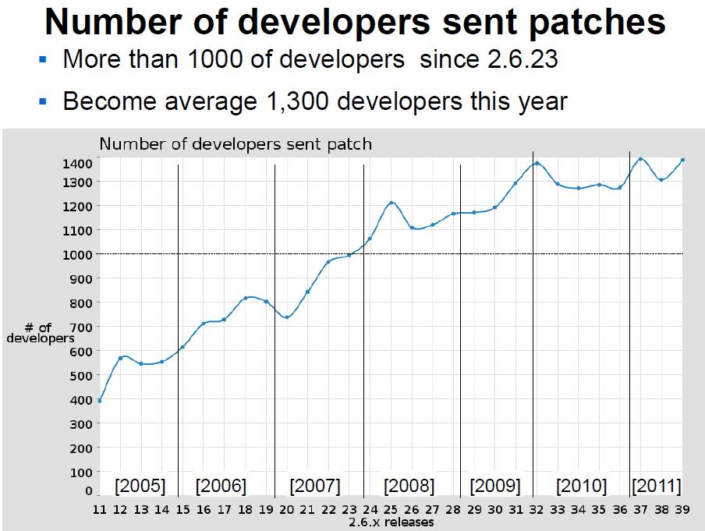
Kernel developer (patch submitter) trends

Slide 9
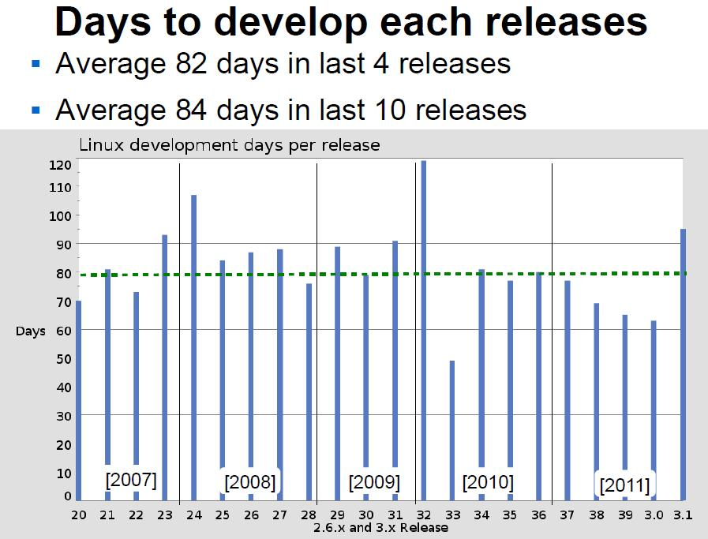
Kernel release interval record histroy

Slide 10
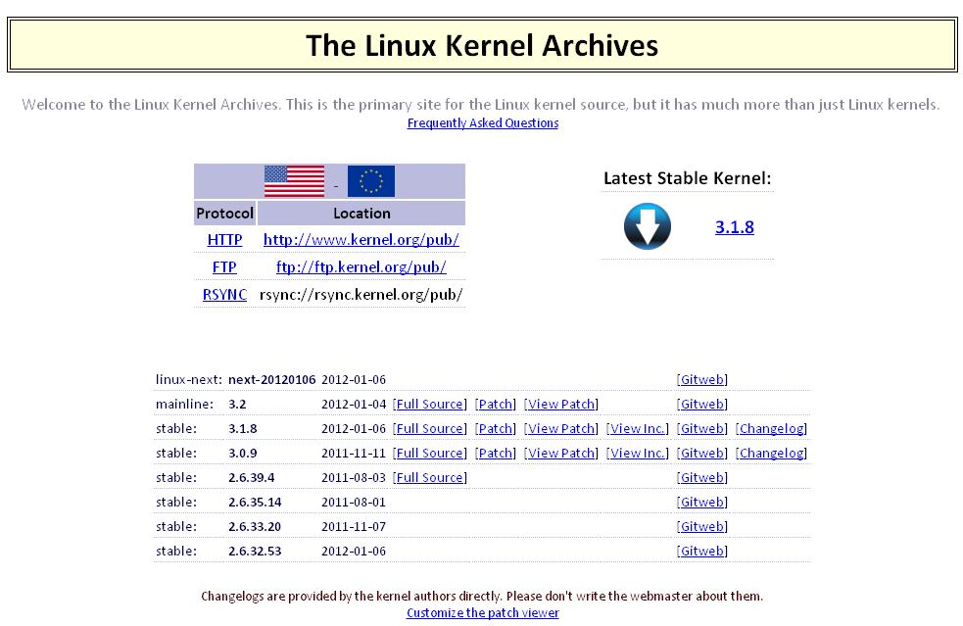
“www.kernel.org” is Linux master repository
②
development
target code
①
long-term
stable code
③

Slide 11
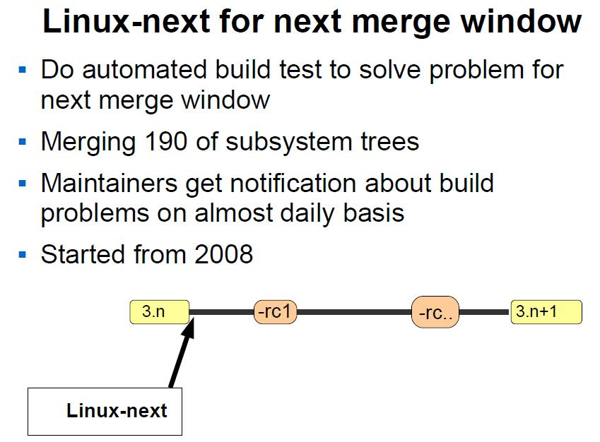
Continuous development process
merge window
test and stablization

Slide 12
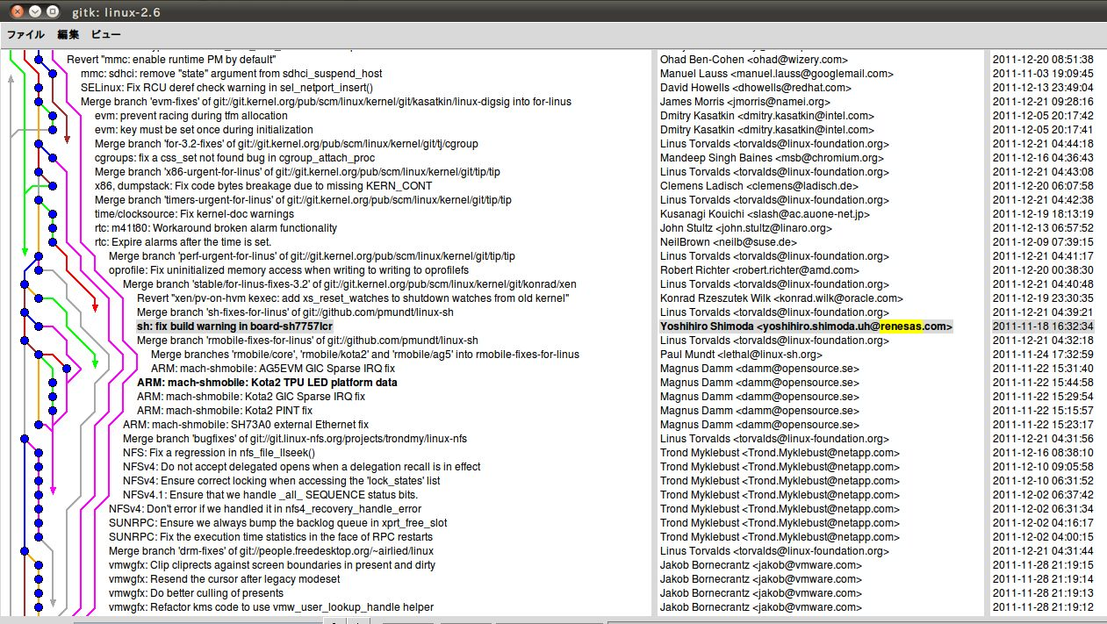
multipoint & concurrent development with “git”
Renesas platform support code merged

Slide 13
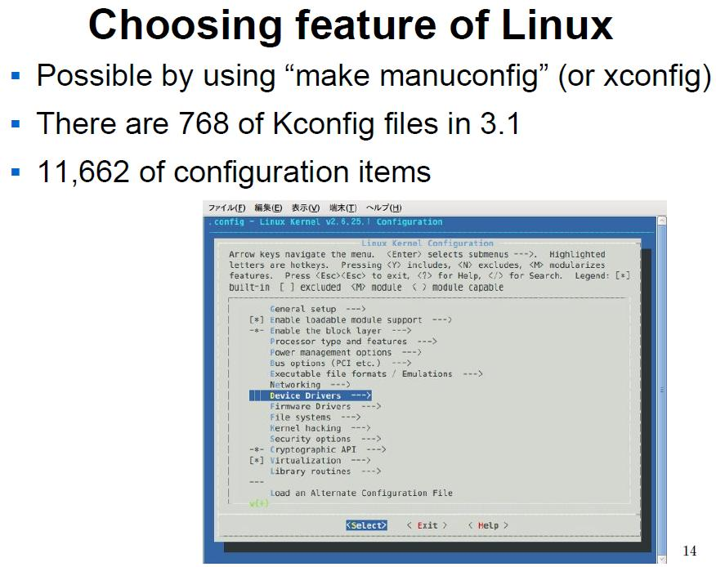
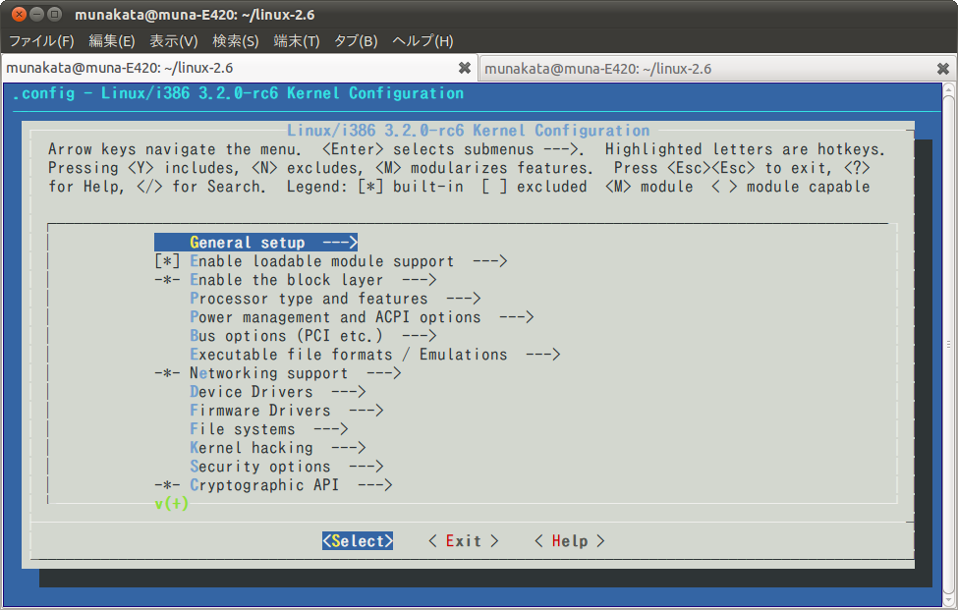
Fully configurable flexible kernel (one source)

Slide 14
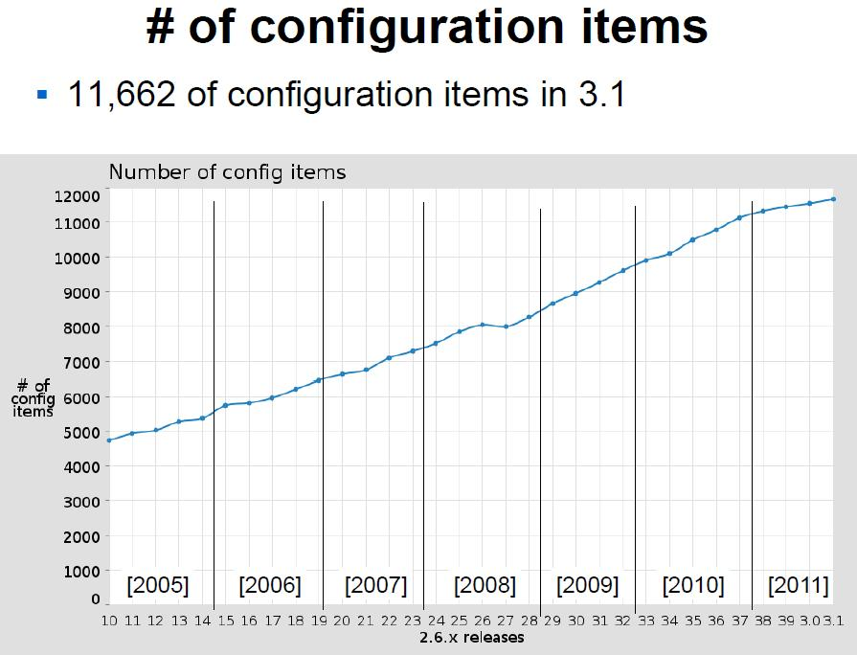
Still growing to support wider coverage

Slide 15
Renesas connection to the upstream

Slide 16





Renesas has ARM kernel submission direct path
“R-Mobile” is now approved as new ARM sub architecture.
Renesas utilize dual path for kernel code submission path.
kernel development
Renesas device
specific patches
in-house developer
Paul Mundt
SH maintainer
rmobile maintainer
MAGNUS
Linus Torvalds
Linux master
community developer
Magnus Damm
ARM committer
Russell King
ARM maintainer
common ARM patches
16

Slide 17
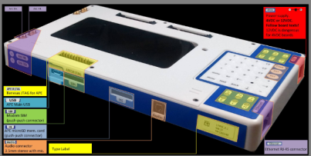

We follow “upstream first” strategy
Renesas eliminate local fork, not to make Galápagos
Upstreaming first
No private kernel tree
minimum
private
code
community
upstream
[kernel.org]
try to minimize
this portion
Develop with community
open project
[Gstreamer,..]
Turnkey
free BSP
Renesas “Kota” World wide Platform
distribution
[Debian,..]
FSF toolchain
[ Linaro, CodeSourcery]
We do not have any vendor closed in-house development tree
17

Slide 18
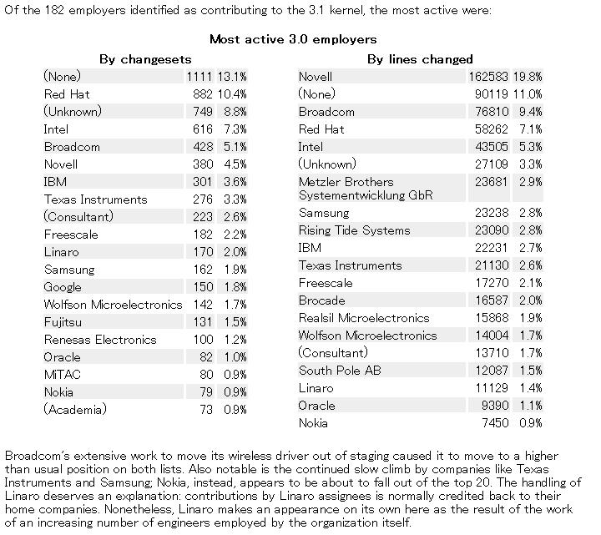
Latest (= kernel 3.1) contribution result
Most active 3.1 employers
http://lwn.net/Articles/460597/

Slide 19
Connected to commercial quality BSP creation
commercial quality BSP
If you build Linux BSP with 3.0 LTS kernel, you can always cherry-pick code from newer kernel that Renesas keep maintaining. This can be perfect resource for commercial BSP.
cherry-pick
appropriate
version
＋
validation,
stress test
regression db
Upstream development
We add Renesas
device support
to upstream code
3.1
3.2
3.3
3.4
upstream kernel evolution
continue work for
every kernel update
3.0
LTS
improve
degrade
ARM adopter
coordination
  3.X RCn
revised design

Slide 20
We work with the dedicated Linux integrator
Just single code for
every purpose like
enterprise / embedded
Intel / ARM / PPC / SH…
UP / SMP / virtualization
Industry
developer
SoC
Industry
developer
handset
hobbyist
community
common-code
development
Industry
developer
distributor
university
professor
validation, homologation
Industry
developer
consortium
Linux
distributor
integrator
university
student
Industry
developer
OEM
Renesas deliver mainlined common code to Linux integrator

Slide 21
4-way Linux support channel
③
System
Integrator
Free evaluation
BSP for startup
①
Customer
project
Upstreaming
Commercial BSP
professional support
②
pull
④
Linux development community upstream master code
Customer can choose appropriate Linux support from Renesas

Slide 22
Qt + SGX integration guide (from Nokia)
Qt Application
Qt Core
Regular Widgets +
QGL/GLWidgets
QWS Server
QRaseterPaintEngine
Window Surface mixture
Allocate Window Surface
Drawing
Graphics
Driver
DirectFB Paint Engine
DirectFB QGLScreen
DirectFB non-supported draw
DirectFB supported draw
DirectFB w/ IDirectFBGL Support
DirectFB Graphics Driver
Window Surface (=DirectFB Surface)
Frame Buffer
Window Surface (=DirectFB Surface)
Frame Buffer
Window Surface (=DirectFB Surface)
Frame Buffer
http://doc.qt.nokia.com/latest/qt-embeddedlinux-directfb.html

Slide 23
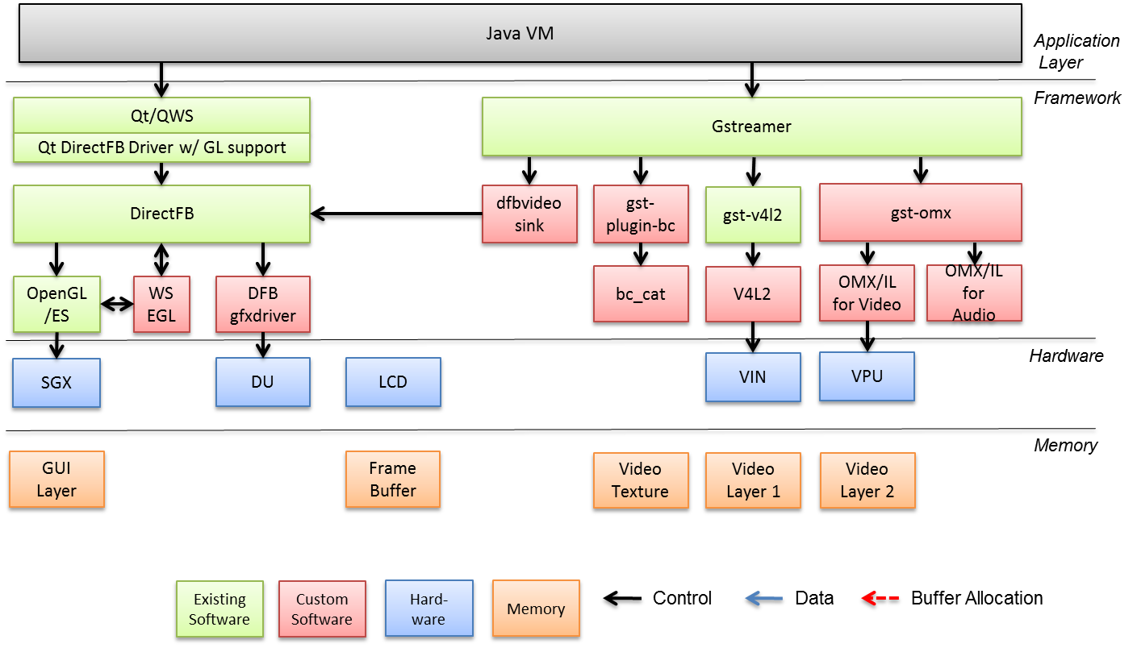
Renesas Qt + SGX integration architecture

Slide 24
Data & control flow : Full Screen Video Playback
Java VM
Application
Layer
Qt/QWS
Gstreamer
Framework
Qt DirectFB Driver w/ GL support
DirectFB
dfbvideo
sink
gst-plugin-bc
gst-v4l2
gst-omx
OpenGL/ES
WSEGL
DFB
gfxdriver
bc_cat
V4L2
OMX/IL
for Video
OMX/IL
for Audio
VIN
VPU
Hardware
SGX
DU
LCD
Memory
GUI
Layer
Frame
Buffer
Video
Layer 1
Video
Layer 2
Existing
Software
Custom
Software
Hard-ware
Memory
Control
Data
Buffer Allocation

Slide 25
Data & control flow : Video as Texture
Java VM
Application
Layer
Qt/QWS
Gstreamer
Framework
Qt DirectFB Driver w/ GL support
DirectFB
dfbvideo
sink
gst-plugin-bc
gst-v4l2
gst-omx
OpenGL/ES
WSEGL
DFB
gfxdriver
bc_cat
V4L2
OMX/IL
for Video
OMX/IL
for Audio
VIN
VPU
Hardware
SGX
DU
LCD
Memory
GUI
Layer
Frame
Buffer
Video
Texture
Existing
Software
Custom
Software
Hard-ware
Memory
Control
Data
Buffer Allocation

Slide 26
Renesas ODIN software architecture (Android)
Native Libraries
Reference Board (Kota)
Android Open Source
Android Sample Applications
System Integration
WLAN
Bluetooth
GPS
Runtime
Dalvik VM
CTS
Android Frame Work
Pegasus
Modem
Multimedia Adaptation
(OpenMAX)
Modem Function
Power
Management
RF
Android Adaptation Layer
RILD
Audio
path
APE5R LSI
Baseband
Multimedia
Integration
Linux kernel with Android private patches
NFC
Connector
On-Board Device Drivers
On-Chip Device Drivers
Media
Video
Codec
Audio
Codec
Display
ctrl
JPEG
Codec
BBIF
GPS I/F
USB Device
SPI
SCIF(UART)
IIC
GPIO
SDIO
SD Card
DMAC
Timer
PMIC
SGX543
MFI Driver
GPS
Camera
eMMC
KEYSC
Touch Panel
Sound
BT
WLAN
ISR
Boot
Real time OS
ARM Cortex-A9 Dual
Real time CPU
Audio I/F
PMIC
(With Audio)
USIM
Connector
Sensor
I/F
Key
Matrix
NAND,
eMMC
SD
Connector
Camera
(In/Out)
LCD Panel
(Touch)
Open Source
Renesas SW (Application domain)
Renesas SW (Real time domain)
Partner SW

Slide 27
Renesas Android multi-media integration
Android/
Stagefright
File
Input
Demux
Video
Decode
Render
Android Original
Code (No Changes)
Audio
Decode
Surface
Flinger
OpenMAX (Bellagio)
OpenGL/ES
OpenMAX Core
OpenGL
/ES
Porting Layer
(Renesas Specific)
OMX
Audio
OMX
Video
WSEGL
Hardware
SPU
VPU
SGX543MP
LCDC/
HDMI
Mux’d Data
MERAM
Video Data
SD
Card
IPMMU (T-L Conversion)
Pointer to
Video Data
Data
NV12
RGB32/NV12
Audio Data

Slide 28

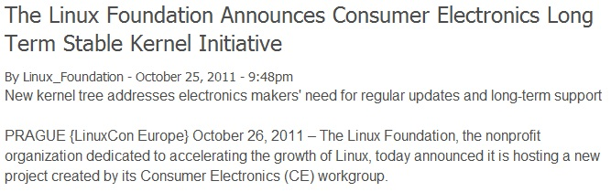
LTSI : Long Term kernel support initiative
Tentative logo
http://www.linuxfoundation.org/news-media/announcements/2011/10/linux-foundation-announces-consumer-electronics-long-term-stable-ke

Slide 29
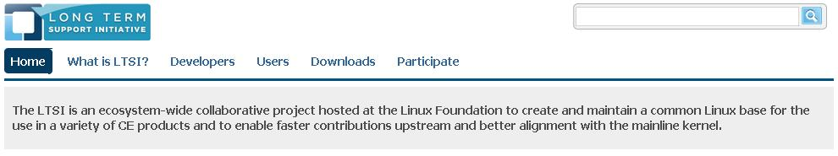
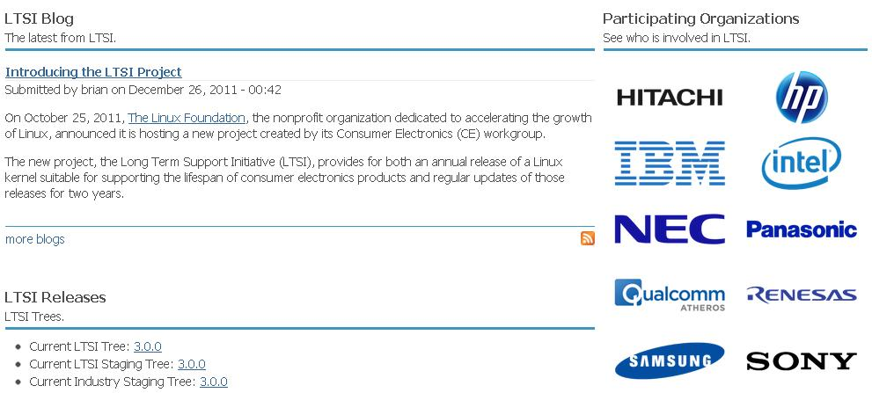
LTSI : long term kernel support initiative
Tentative web site image

Slide 30
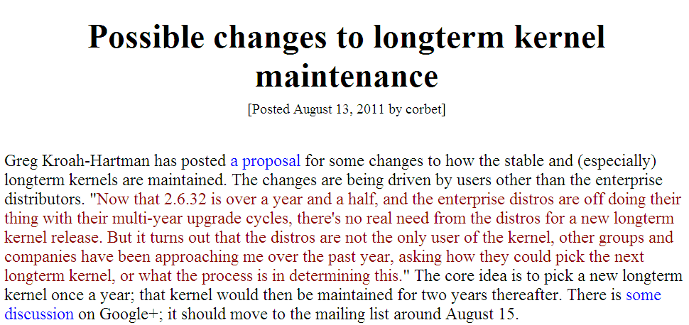
Community stable kernel support policy change
http://lwn.net/Articles/454886/

Slide 31
LTSI vs. LTS (community stable kernel)
LTSI : long term support kernel
Back-port newly added device / platform support from new kernel.
Back-port new kernel feature to improve code functionality like PM.
We can apply newly added (to 3.2 and later) Android code to 3.0.
SoC vender specific new code that are still in Linux-next can be added.
Some embedded target kernel enhancement also can be added.
Community LTS
Safe bug fix already verified and merged new kernel.
Serious security fix already verified and merged new kernel.
Upstream vanilla kernel
Renesas will add our latest SoC support into stable kernel with LTSI

Slide 32

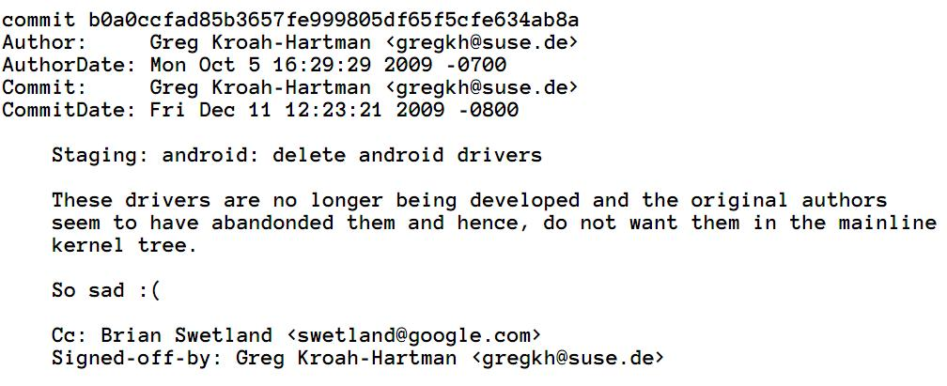
Resolution of past Android isolation issue
http://elinux.org/images/c/ca/Gregkh-android-presentation-kernel.pdf

Slide 33
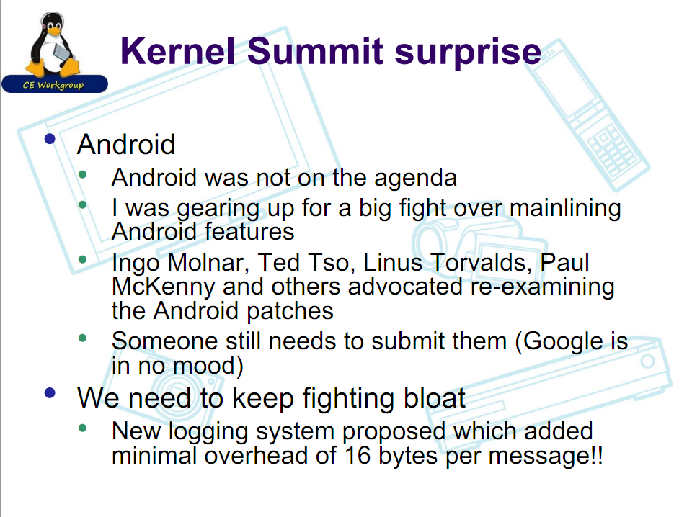
Android discussion @kernel summit 2011
http://elinux.org/images/7/70/Status-of-Embedded-Linux-2011-12-JJ39.pdf

Slide 34
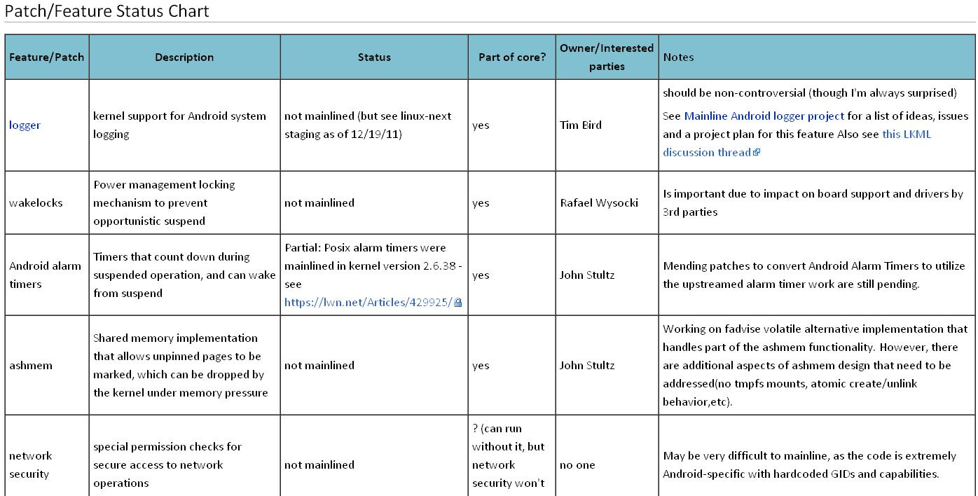
Android Mainlining Project @elinux wiki
Target feature set list is continued ….
http://elinux.org/Android_Mainlining_Project
Renesas is leading Runtime PM integration to Android now

Slide 35
Runtime PM (Power Management) update
Better power management to achieve longer battery operation time is getting essential requirement for modern smartphone as its CPU clock and core number is becoming bigger and bigger. At the same time PM code is most touchy part of Android as it has adopted non standard way of power-state control. Renesas is working hard to solve this issue using already mainlined “Runtime-PM” concept.

Slide 36
Linux (and Android) key power control factors
CPU
  CPU hot-plug (per core of/off control)
  CPI idle (cut down unused core power)
  These control can be integrate to DVFS control.
Device
  Device clock control
  per on-chip IP/on-board-device control
  per power-domain power control
Runtime PM is designed to manage all these control points.

Slide 37
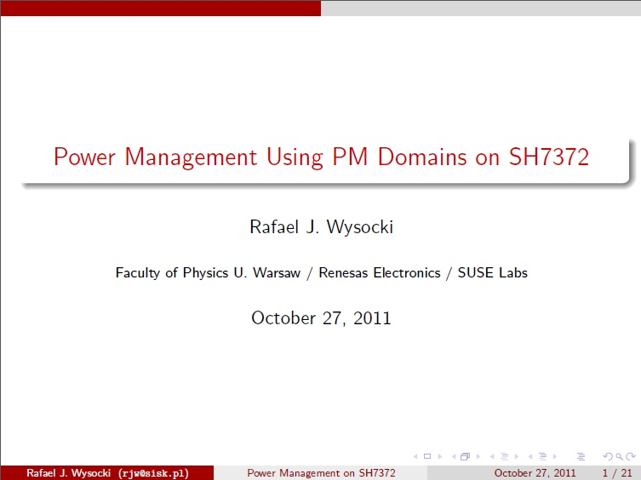
Trial Runtime PM integration on Renesas SoC
Renesas work with community leading PM developer

Slide 38
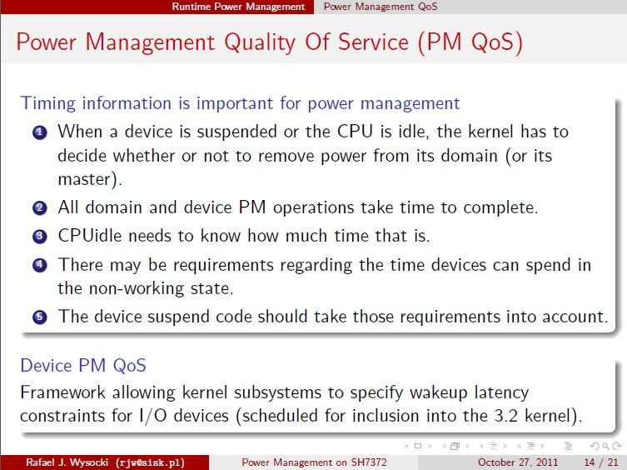
Trial Runtime PM integration on Renesas SoC
“PM QoS” is very important mechanism to better efficency

Slide 39
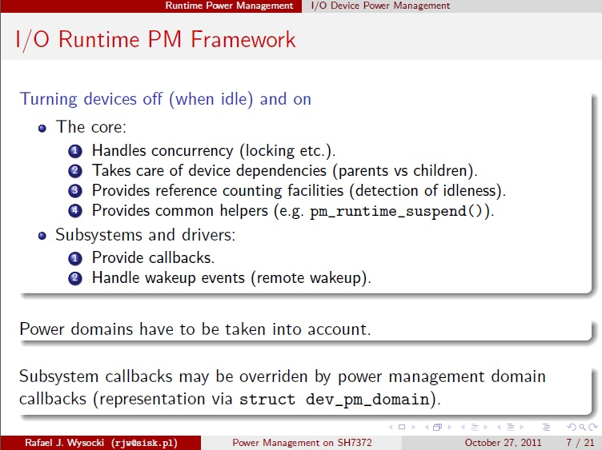
Trial Runtime PM integration on Renesas SoC

Slide 40
ARM Linux updates
Historically ARM corporation provides CPU core portion only and each SoC company designed own Interrupt Controller, Timer and DMA to make their products. Due to this reason Linux ARM code becomes pretty duplicated and confused status compared to other major CPU architecture. 2012 will be the first year to re-organizing ARM code in Linux kernel.

Slide 41
ARM Linux kernel issues
Current confusion
  vendor private tree integration issue.
  upstreaming path confusion issue.
  Linaro start fixing this with ARM-SoC tree
  No common platform like x86 PC
  ( No single binary kernel image for ARM )
  DT (Device Tree) would be the solution.
  New core (CA15, bigLITTLE etc.) support

Slide 42
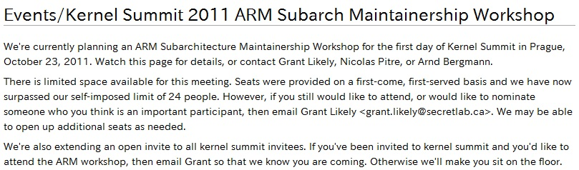
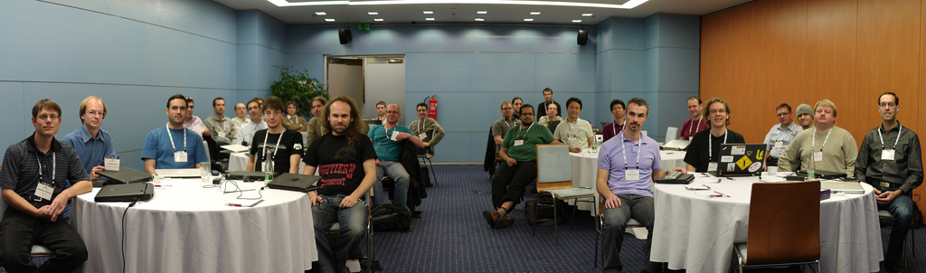
1st ARM maintainer workshop @kernel summit
http://elinux.org/Events/Kernel_Summit_2011_ARM_Subarch_Maintainership_Workshop
Renesas is a part of future ARM kernel consolidation discussion

Slide 43

Working with Linaro
Linaro is a membership organization to develop common ARM Linux kernel code as a open project. Renesas is not
a member of Linaro so far, but we can work with Linaro project from the upstream community support connection.
We plan to adopt Linaro toolchain for CA15,..
Linaro will follow LTSI project.
LinaroConnect 12Q1 and Embedded Linux Conference [ELC2012] is co-located in February 2012 @Redwood city CA. USA.

Slide 44
Conclusion
Renesas had been contributing a lot for Linux
and opensource development. Therefore we
understand how to collaborate with community.
We are in the circle of latest advanced software
discussion like advanced PM integration or ARM
kernel renovation. So we can add most advanced
software technology into our BSP delivery.
Linux and Android software platform is huge resources that requires broad range of support.
We are flexible to collaborate with any distributor which handset vendor prefers to achieve that.

