Slide 1

SW as a capital
  Develop reusable SW from the beginning
Hisao MUNAKATA
Senior director, HPC marketing digital division
DAN SISCO
Senior director, R-Car Gen5 Program Manager
High performance computing, Analog and power solutions group
Renesas Electronics Corporation

Slide 2
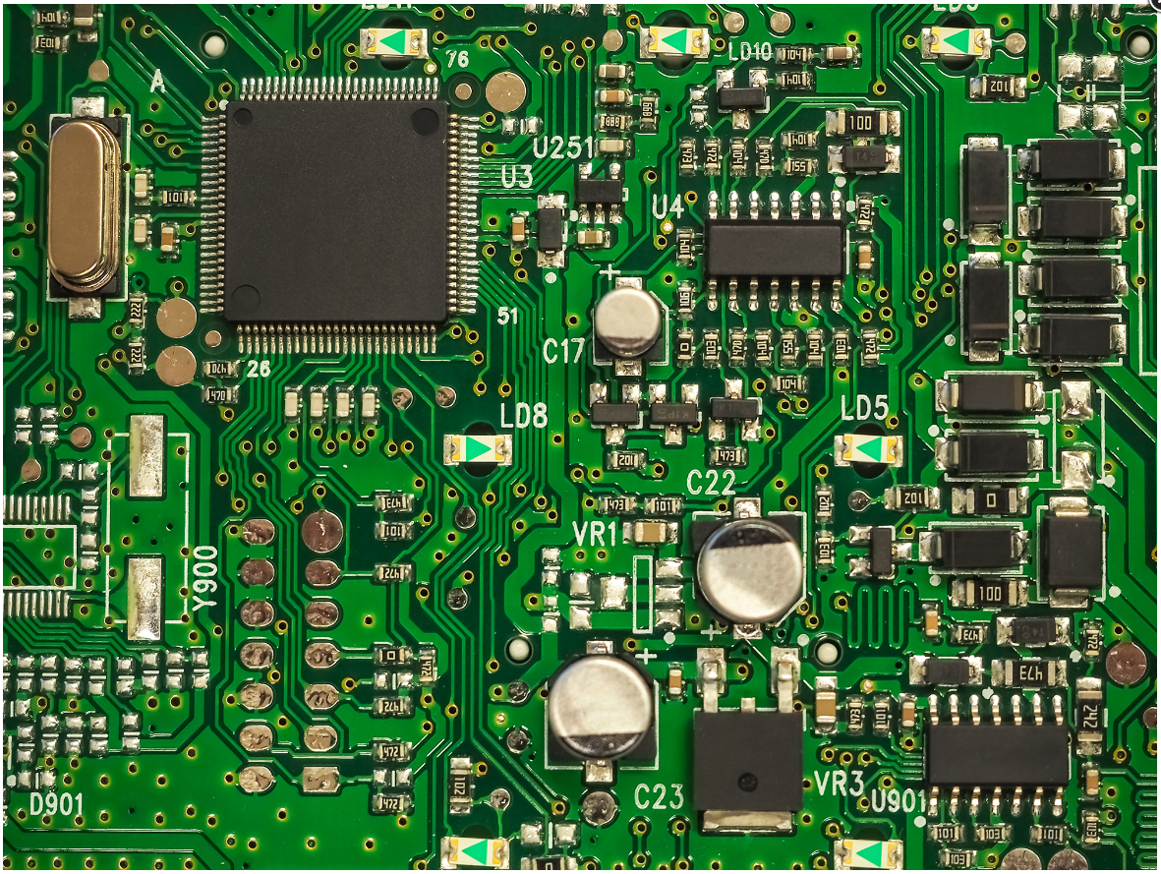
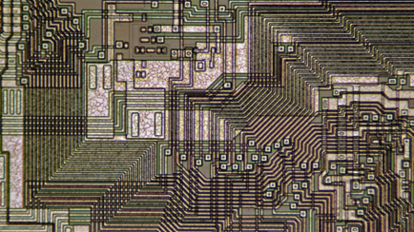
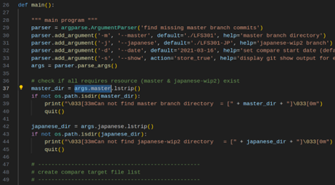
transition of innovation source how sW became the center of technological gravity
 | In the past | Recently | In the future
Core competitiveness | PCB circuitry | SoC | SW
Technology owner | Tier1 | Silicon supplier | SW platformer
Key demand | robustness | integration | portability
Image
Challenges | ECU interconnect, age-related fault | Performance, power (thermal) | SW update, cyber security
Now, many OEMs claim SW has become a primary source of product competitiveness (= SW first concept)

Slide 3
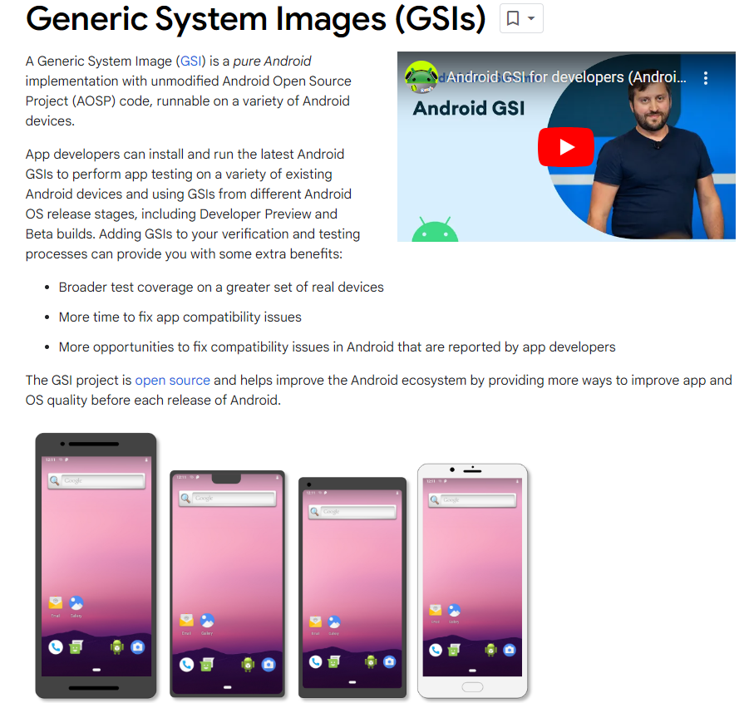
still, one size (SW) does not fit all
Embedded systems hardly decouple HW (SOC) and SW
HW
variation
Require performance (=price) variants
Expect unique competitive features
(display numbers, AI,..)
SW
commonality
Production variants (same generation)
SW migration (across the generation)
HW/SW
boundary
Application portability (OS interface)
HW access interface (common API)
System level boundary
https://developer.android.com/topic/generic-system-image
Android mandates handset vendors to support GSI boot, a common binary that can boot multiple devices.

Slide 4




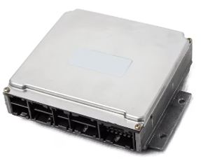
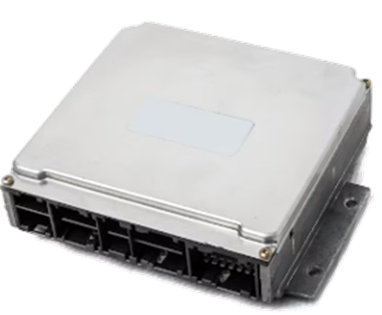
Expected SW reuse candidates
… and various blocking factors for embedded SW reuse
OEM A
⑤ SW reuse across different OEMs
(open industry collaboration )
OEM B
Tier1 A
Tier1 B
② Same Tier1,
different OEM
① Same OEM,
But different Tier1
③ Same Tier1,
different team
④ Same Tier1
Different generation

Slide 5
Various Blocking factors for SW reuse not only HW-oriented, but also SW-related and business-related
HW origin
SW origin
Business origin
  Performance
    Speed
    Memory size
  Major IP incompatibility
    CPU / GPU / NPU
  Minor IP incompatibility
    Register function assign
    Channel number
  Environment
    IDE, debug board,..
  Data definition
    Common language
  Coding convention
    MISRA-C
  Code management
    Repository access
  Readability
    Document density
    Language
  Contract
    Code disclosure
    Asset ownership
  License
    Copyright restriction
    Warranty scope
  Deliverables
    Source code access

Slide 6

SW as a capital, not an asset
Capital should be resourced to generate repeated future value
SW as an Asset (traditional way)
SW as a Capital (new direction)
Acquired to date
Accumulated over time
Care for the preservation of assets
The value diminishes over time
Hard to maintain the present value
Becomes a non-performing asset
Source of future value
Core of the growth strategy
To increase the prospective value, you need to reinvest in the SW
SW management strategy should include “What exactly to do for expansion and reinvestment?”
Collection of past SW code became bad debt

Slide 7
“Capital turnover rate” gives performance index it shows how much revenue generated from the existing asset
Capital Turnover Rate = Annual sales / stockholder equity (net worth)
  The ratio indicates how much a company could grow its current capital investment level.
  Its value varies by type of business. (1.3 ~ 3.5)
SW Capital turnover Rate = Reused code / Total developed code
  We can calculate the true code reuse rate.
  That does not include the use of vague experience and know-how.
  We need to consider how we can improve the true code reuse ratio.
Capital Turnover Rate (Accounting terms)

Slide 8
How to realize capitalized SW (= reusable SW)
”Reuse” is essential for SW capitalization
Eliminate Assumptions
Follow
Coding Conventions
Interoperability with
other industries
Do not optimize the code
Style format
(tab length, codepage,..)
Pursuit of readability
(doxygen support,..)
Nomenclature
(adopt common naming)
Use code control system
(proper use of git system)
Cloud connectivity
Mobile network connectivity
Vehicle service connectivity
common control vocabulary (shared semantics) for data sharing/integration
Optimize may include assumption
HW configuration (ch. number)
Data range
Memory size
Execution speed (network,..)

Slide 9
WHAT COVESA contributes to realize capitalized SW
Covesa hosts various collaborative projects that promote SW capitalization
Data Expert Group
Automotive AOSP App Framework Standardization Expert Group
Electric Vehicle Charging Expert Group
Data Models & Science
  VSS eco-system
Common Vehicle Interfaces
  VehicleAPI (Autosar)
  Service definitions
  VISS
  IFEX IDL framework
Architecture / Infrastructure
  Data Layer
  Data Centric Arch
Non-GAS emulator
Data/Sensor API Definition
  e.g. camera
Push Notifications
Login & Identification
Payment
Location Based Services
Driver distraction
Display management
Touchpad support
EV Charging Event Data Aggregation
EV Optimization
Private Cross OEM Joint Compute for Changing
Delivering great EV experiences

Slide 10
Translating Sw capitalization to renesas development pillars to support the transformation
Create SW Re-investment Strategy
Eliminate Assumptions
Improve Industry Collaboration
Single Mainline Dev’t
Cloud Native Dev’t
Simulation Enabled Dev’t
Increased Standardization via Consortium and OSS Leadership and Participation

Slide 11
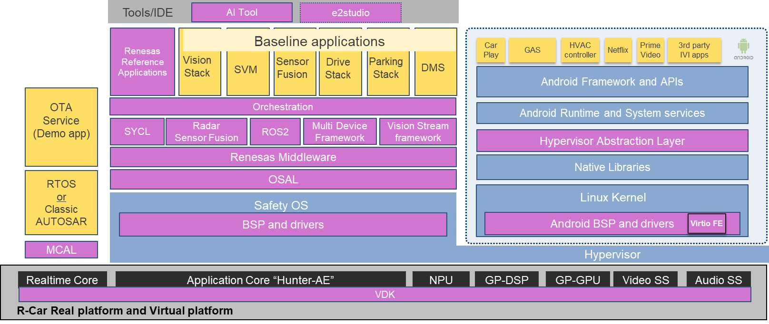
Renesas pillars to pursue SW capitalization single mainline development
Single Mainline Dev’t
“Single mainline” development co-locating and integrating all SW features at right
Increased chipset and vehicle system integration planning and test
  better visibility into SW re-use in real world cases
Optimizations and customizations become branches from here
Make smart optimizations to avoid jeopardizing SW re-useability

Slide 12
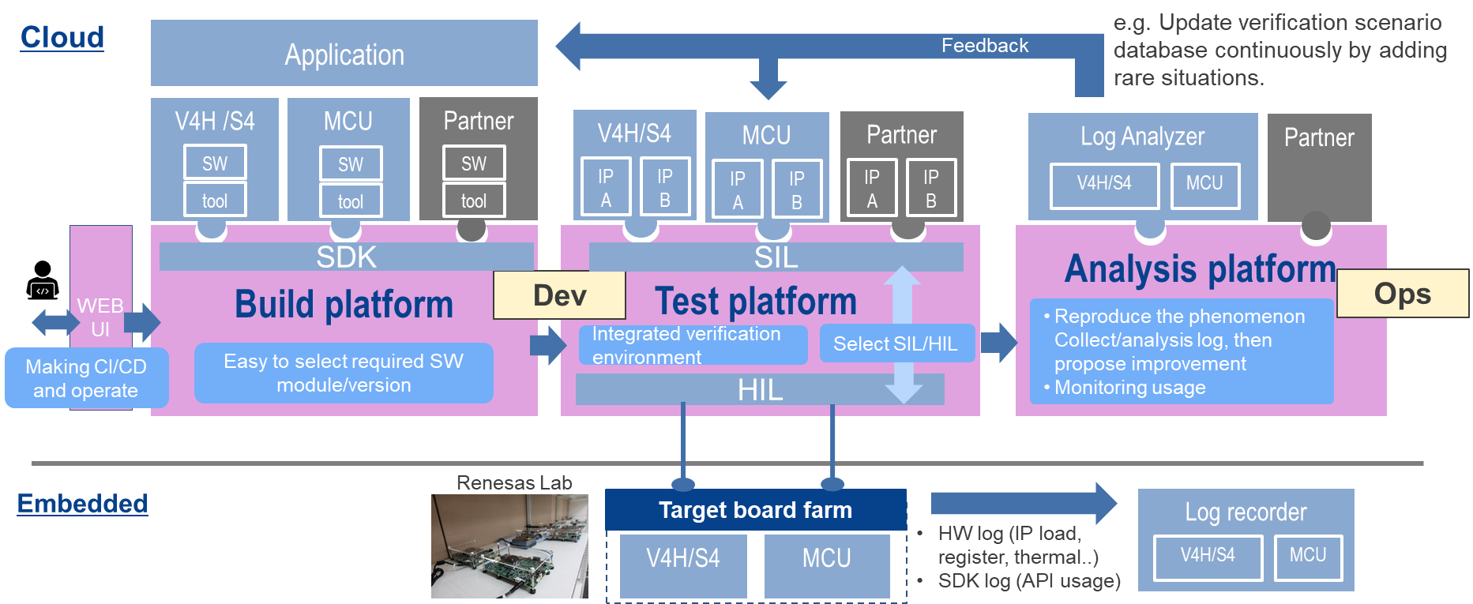
Renesas pillars to pursue SW capitalization cloud native development throughout vehicle lifetime
Cloud Native Dev’t
“One stop shop”: Single point of entry and operation for complete SW dev’t workload
  Product Simulation (fast/medium/slow)
  AI analysis/simulation
  Documentation/SW access
  Compute rental mechanisms (HiL, SiL)
Cloud Native to pull Dev’t Left and Enable Broader and Easier SW Access

Slide 13
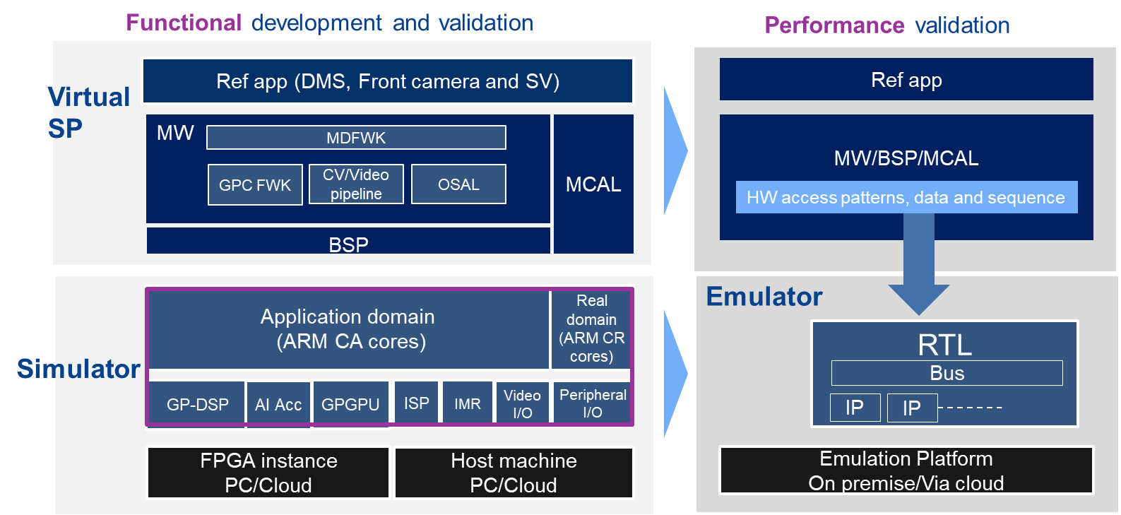
Renesas pillars to pursue SW capitalization simulation enablement from the start
Simulation Enabled Dev’t
Renesas Automotive SW IDE includes simulation components since 2021
  Multi-device simulation
  Enhanced debug/trace
Now we expand on this
  Flexibility of simulation (speed/accuracy)
  Deeper AI toolchain simulation
Decouple SW Value and Strategy from HW Access

Slide 14
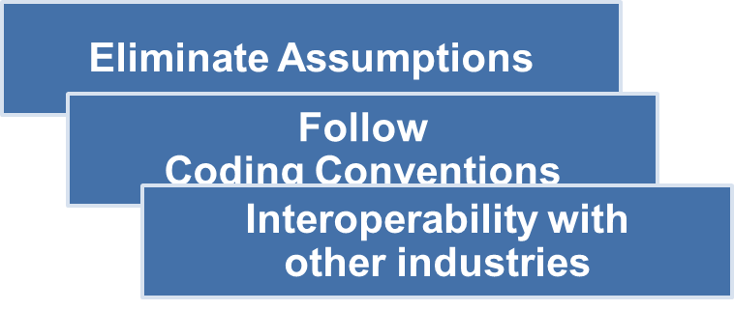
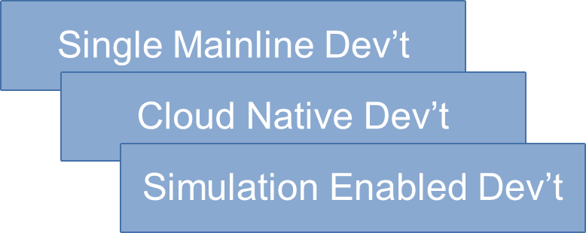
Our journey…
Renesas is making great efforts to master our own journey towards SW capitalization, and to enable our customers and partners to master their own journeys…
SW as a Capital (new direction)
General
methods
renesas
approach

Slide 15
Renesas.com

