Slide 1

LTSI Project update
Long Term Support Initiative
Tsugikazu SHIBATA
20, June. 2018@at Open Source Summit Japan, Ariake Tokyo
(replay by) Hisao Munakata
18, October 2018 @ AGL AMM Fall Dresden
update
Notes:
<番号>

Slide 2
Linux = Open Source project
Linux is one of the most successful Open Source project
Continue growing in 27 years ; expanding adoption for new area;
  IT enterprise, Cloud, Network, Smart Phone, Robotics, Embedded, IoT and many others
Developing and delivering under GPLv2

Slide 3
Developed by the community
Participating ~1700 developer, ~230 companies every releases
Growing yearly 1.5Mlines of code, 4000 files increased
27 Years of history
Maintainers have great skill to manage the subsystem and professional knowledge of its area of technologies

Slide 4
Status of Latest Linux Kernel
Latest released Kernel : 4.18
  Released: August 12nd , 2018
  Lines of code : 25,280,872 (-98,692)
  Files : 60,973 (-359)
  Developed period: 70 days from 4.17
Current Stable Kernel: 4.18.14
Current development kernel: 4.19-rc8
update

Slide 5
Kernel release cycle
Release cycle: 65 ~ 70 days, 5~6 releases/year
Version | Release | Rel. span
3.19 | 2015-2-9 | 64
4.0 | 2015-4-12 | 62
4.1 | 2015-6-22 | 71
4.2 | 2015-8-30 | 69
4.3 | 2015-11-2 | 64
4.4 | 2016-1-10 | 68
4.5 | 2016-3-14 | 64
4.6 | 2016-5-15 | 63
4.7 | 2016-7-24 | 70
4.8 | 2016-10-2 | 70
Version | Release | Rel. span
4.9 | 2016-12-11 | 70
4.10 | 2017-02-19 | 60
4.11 | 2017-04-30 | 80
4.12 | 2017-07-02 | 63
4.13 | 2017-09-03 | 63
4.14 | 2017-11-12 | 70
4.15 | 2018-1-28 | 77
4.16 | 2018-4-1 | 63
4.17 | 2018-6-3 | 63
4.18 | 2018-8-12 | 70
5
5
6
update

Slide 6
Linux development policy
Upstream is only the place to accept the patches
  Reviewed by skilled maintainer
  Tested with other proposals to confirm no conflicts
  Well coordinated development process for over thousands of developers
Upstream
Fixes
New Features
(Bug/Security)

Slide 7
Linux Development process
Just after the release of 4.n, two weeks of merge window will be opened for proposal of new features
After 2 weeks of merge window, -rc1 will be released and the stabilization will be started
4.n+1 will be released when it becomes reasonably stable by some of -rcX released
Merge
Window
(2weeks)
Stabilization
4.n
-rc1
-rc2
-rc3
-rc4
-rcX
4.n＋１

Slide 8
Linux Source Code Growth
Increasing 0.3ML/Version, 1.5ML/year

Slide 9
Stable kernel release
4.n
4.n+1
4.n+2
4.N+1 Development
EOL
EOL
4.n.1
4.n.2
Recommended branch for users who want the most recent stable kernel
3 part version like 4.n.m
Contain small and critical fixes for security problems or significant regressions discovered in a latest development version
Becomes “End Of Life” when next stable kernel were released

Slide 10
LTS: Long Term Stable Kernel
Extended maintenance period for stable kernel
Kernel tree continue to back port bug and Security fixes for more long term
Pick one version per year and maintain 2 years
Development Release
Stable Release
LTS

Slide 11
Status of Latest Linux Kernel Again
Latest released Kernel : 4.18
Current Stable Kernel : 4.18.14
Current development kernel : 4.19-rc8
4.19-rc8
4.18
4.19 Development
update
4.18.14

Slide 12
Why LTS?
Only the tree get fixes from the community
In the real use case, tested/confirmed kernel is important, less important for new features
Security/Bug Fixes will be released weekly or more and that should be applied
LTS will be released around November/ December time frame for easier for planning

Slide 13
Current LTS versions
Version | Maintainer | Released | Projected EOL | Years
4.14 | Greg Kroah-Hartman | 2017-11-12 | Jan, 2020 | 2
4.9 | Greg Kroah-Hartman | 2016-12-11 | Jan, 2023 | 6
4.4 | Greg Kroah-Hartman | 2016-01-10 | Feb, 2022 | 6
4.1 | Sasha Levin | 2015-06-21 | May, 2018 | 3
3.16 | Ben Hutchings | 2014-08-03 | Apr, 2020 | 6
3.2 | Ben Hutchings | 2012-01-04 | May, 2018 | 6
update
https://www.kernel.org/category/releases.html

Slide 14
Support period of LTS Kernels
We are Here
2010
2011
2012
2013
2014
2015
2016
2017
2018
2019
2020
2021
2022
ｖ3.0
7/21
11/5
ｖ3.2
1/4
ｖ3.4
5
5/20
ｖ3.10
4
6/30
10
ｖ3.12
11/3
ｖ3.14
5
3/30
ｖ3.16
11/5
8/30
ｖ3.18
4
12/7
ｖ4.1
6/1
ｖ4.4
5
1/10
ｖ4.9
2
12/11
ｖ4.14
1
11/12
ｖ4.1?
1

Slide 15
LTS includes large number of fixes
update
600 – 700 fixes included in a Stable release
LTS include several thousands of fixes
As of 2018/10/16
Version FROM-TO |  | #Commits
3.2 | 3.2.99 | 8531
3.3 | 3.3.8 | 698
3.4 | 3.4.113 | 5929
3.5 | 3.5.7 | 816
3.6 | 3.6.11 | 757
3.7 | 3.7.10 | 718
3.8 | 3.8.13 | 996
3.9 | 3.9.11 | 746
3.10 | 3.10.108 | 6705
3.11 | 3.11.10 | 677
Version FROM-TO |  | #commits
3.12 | 3.12.74 | 7746
3.13 | 3.13.11 | 903
3.14 | 3.14.79 | 4977
3.15 | 3.15.10 | 703
3.16 | 3.16.59 | 9042
3.17 | 3.17.8 | 884
3.18 | 3.18.112 | 6821
3.19 | 3.19.8 | 873
4.0 | 4.0.9 | 757
4.1 | 4.1.52 | 6695
Version FROM-TO |  | #commits
4.2 | 4.2.8 | 903
4.3 | 4.3.6 | 618
4.4 | 4.4.161 | 9760
4.5 | 4.5.7 | 973
4.6 | 4.6.7 | 705
4.7 | 4.7.10 | 912
4.8 | 4.8.17 | 1102
4.9 | 4.9.133 | 9871
4.10 | 4.10.17 | 1136
4.11 | 4.11.12 | 984
Version FROM-TO |  | #commits
4.12 | 4.12.14 | 837
4.13 | 4.13.16 | 883
4.14 | 4.14.76 | 7378
4.15 | 4.15.18 | 1616
4.16 | 4.16.18 | 1749
4.17 | 4.17.19 | 1642
4.18 | 4.18.14 | 1559
LTS
EOLed LTS
Stable

Slide 16
# of Yearly fixes in LTS
LTS include 1 ~ 3 thousands of fixes every year
Continue to apply these patches are very important for the security viewpoint
As of 2018/5/7
Version | Maintainer | Released | Years maintained | Total Commits | Fixes/year
4.14 | Greg Kroah-Hartman | 2017-11-12 | 0.6 | 4800 | 4800
4.9 | Greg Kroah-Hartman | 2016-12-11 | 1.5 | 8212 | 5474
4.4 | Greg Kroah-Hartman | 2016-01-10 | 2.4 | 8516 | 3548
3.16 | Ben Hutchings | 2014-08-03 | 4.2 | 8437 | 2008

Slide 17
# of Yearly fixes in LTS
LTS include 2 ~ 8 thousands of fixes every year
Continue to apply these patches are very important for the security viewpoint
As of 2018/5/7
Version | Maintainer | Released | Years maintained | Total Commits | Fixes/year
4.14 | Greg Kroah-Hartman | 2017-11-12 | 0.9 | 7378 | 7378
4.9 | Greg Kroah-Hartman | 2016-12-11 | 1.9 | 9871 | 5150
4.4 | Greg Kroah-Hartman | 2016-01-10 | 2.8 | 9760 | 3445
3.16 | Ben Hutchings | 2014-08-03 | 4.3 | 9042 | 2128
update

Slide 18


Overview of Meltdown and Spectre
Name | CVE | Solution in Linux | Note
Spectre V1 Bounds Check Bypass (Variant1) | CVE-2017-5753 | Fixes for X86 and ARM Available. Driver need to do more | Back ported to LTS 4,4, 4.9, 4.14. ARM is different
Spectre V2 Branch Target Injection (Varinat2) | CVE-2017-5715 | Fixes for X86 and ARM Available as Retpoline implementation | Back ported to LTS 4.14, 4.9, 4.4 Java script/Brower update may needed for side channel attack
Meltdown Rogue Data Cache Load (Variant3) | CVE-2017-5754 | PTI(Page Table Isolation) X86 and ARM Fixes were different | Back ported to LTS 4.14, 4.9, 4.4
Please CHECK by yourself for the latest status, things are changing time by time.

Slide 19
Overview of Meltdown and Spectre
Name | CVE | Solution in Linux | Note
Rogue System Register Read (Variant3a) | CVE-2018-3640 | Expects X86 only and need to update CPU Microcode. | Kernel fix for Metldown solve this problem
Speculative Store Bypass (Varinat4) | CVE-2018-3639 | SSBD(Speculative Store Bypass Disable) handling ARM fixes not yet | Available for 4.9.102, 4.14.43, 4.16.11 Microcode update required for full protection
Lazy Floating point state restore (Variant5) |  | Linux kernel fixed in 2016 | Details to be published June27
Please CHECK by yourself for the latest status, things are changing time by time.

Slide 20
Regular Kernel Update
Meltdown/Spectre problem tell us
  Security problem is #1 priority, need to provide immediate fixes
  Area of fixes are unexpected so that sync with LTS is very important
  Cherry picking patches are being difficult to confirm
    Number of fixes will come later
Applying ALL the LTS patches is the best way, cherry picking patches possibly have problem

Slide 21
Why all the patches?
Patches are based on latest LTS kernel that is based on all patched source code
If you applied cherry picked your preferred patches only, that will become not same as latest LTS and finally, newer important patch may not be applied
  Because of rack of other patches
Whole set of patches need to apply if you wanted to use your kernel for long term

Slide 22
Case of LTS 4.14
4.14 released in 2017-11-12, Now 4.4.50 is there
Monthly 6 to 9 release happening for 4.14.x
Monthly , Bi-monthly or
quarterly kernel update
may reasonable
# of releases for month
Month | 4.4 | 4.9 | 4.14
2017/12 | 5 | 7 | 7
2018/1 | 6 | 6 | 6
2 | 5 | 6 | 7
3 | 7 | 7 | 9
4 | 4 | 5 | 6
5 | 5 | 8 | 9
6 | 3 | 4 | 3
As of 2018/06/18

Slide 23
What’s the problem?
Need to test new kernels for every LTS, it takes more cost and time to maintain
  Use Automated test such as Fuego/KernelCI
  Use common test suites and share the results
  Make consensus of common tests and develop it
  Continue to discuss further

Slide 24
LTSI Status

Slide 25
What is LTSI
Open Source community to create and maintain LTSI kernel tree for long term
  Based on LTS, All the LTS patches are applicable
  Add another chance to include further patches on top of LTS, That is LTSI tree
    Self contained changes or future upstream code
    Drivers for LTS, developed after LTS release
  Industry party to share best practice and help companies to use Linux for long term

Slide 26
LTSI includes LTS
LTSI
Be able to add required features on top of LTS
Share status, info, problem among industry people
Huge testing by contributors
Auto test frame-work
Provide help developer for upstream
LTS
Release 1 version / year, Maintain 2 years
Frequently and large number of bug /security fixes

Slide 27
LTSI 2018 Development plan
2017
2018
2019
10
11
12
1
2
3
4
5
6
7
8
9
10
11
12
1
2
4.14
4.15
4.16
4.17
4.18
4.19
4.14 LTS
Preparation
MW
VP
Yocto
LTSI 4.14 Release
AGL GG
You will be able to have chance to add new patches on top of 4.14 in LTSI Merge Window (Note: The patches should be already in –next or self contained)
Merge Window Open | Merge window Close | Validation Start | Release
August 1st | End of August | Right after Merge window closed | End of September

Slide 28
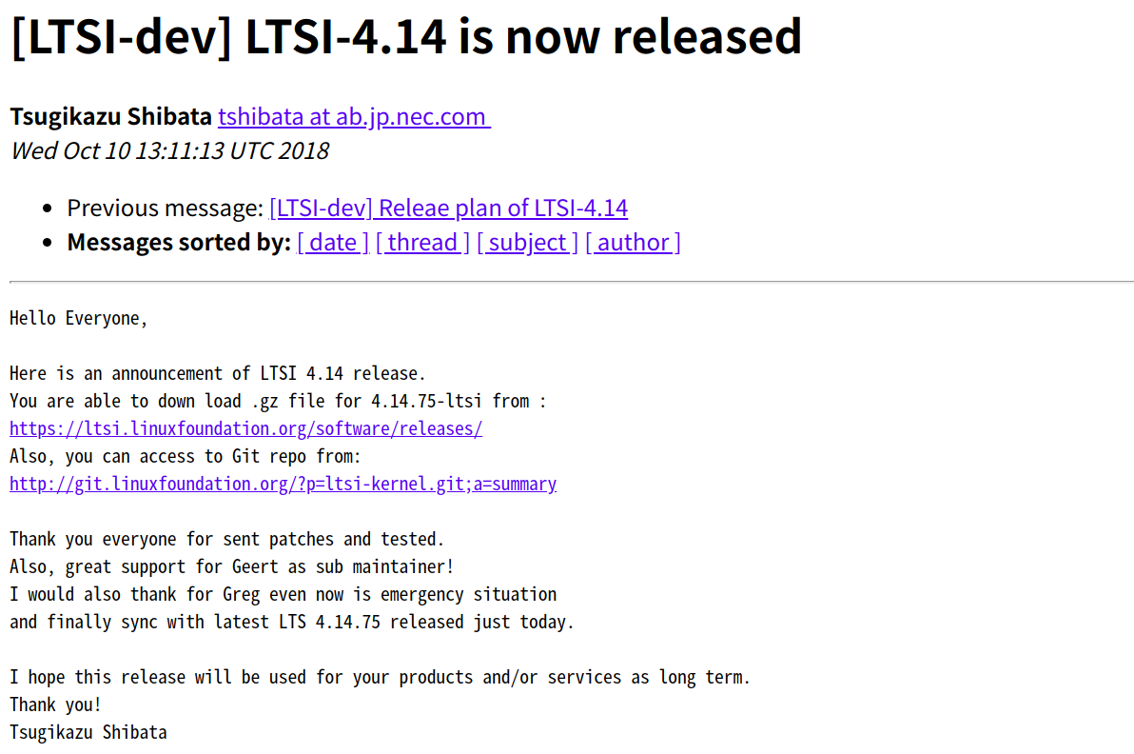
LTSI 2018 developemt result
update

Slide 29
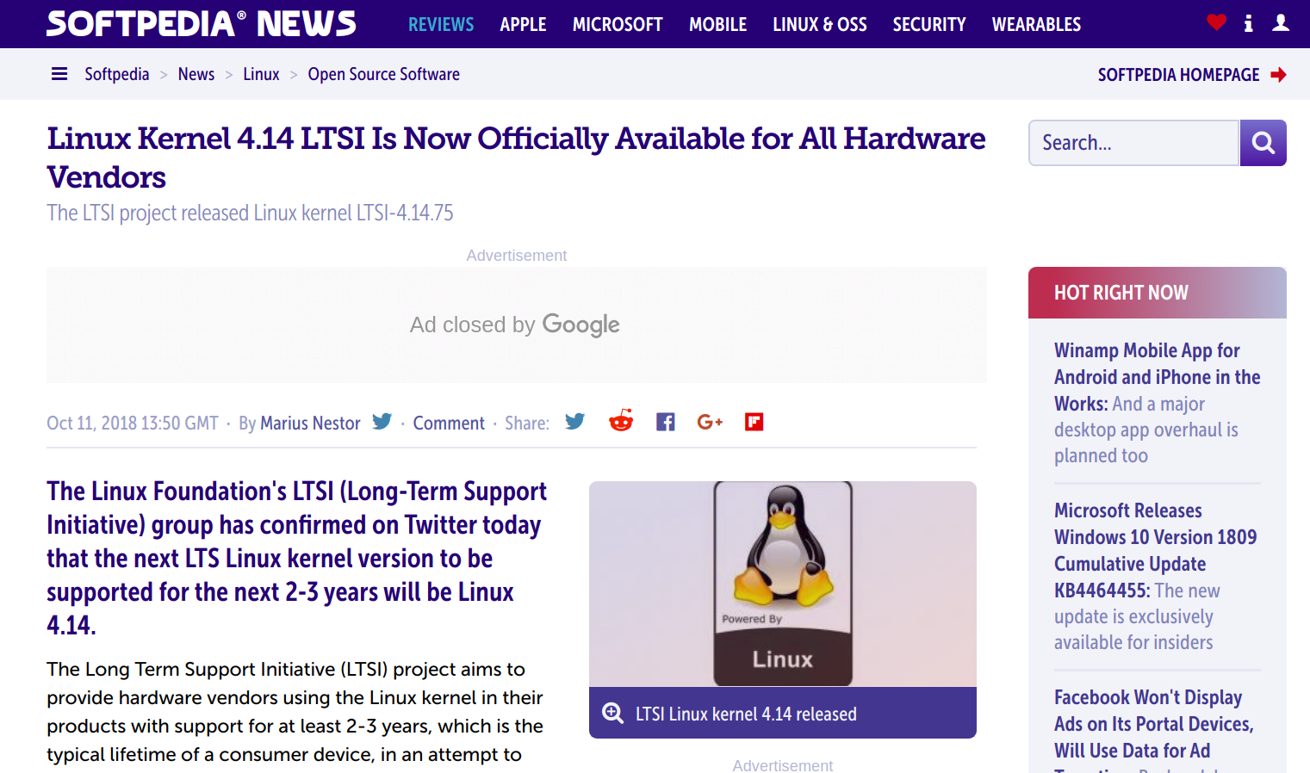
update
https://news.softpedia.com/news/linux-kernel-4-14-lts-is-now-officially-available-for-all-hardware-vendors-523188.shtml

Slide 30
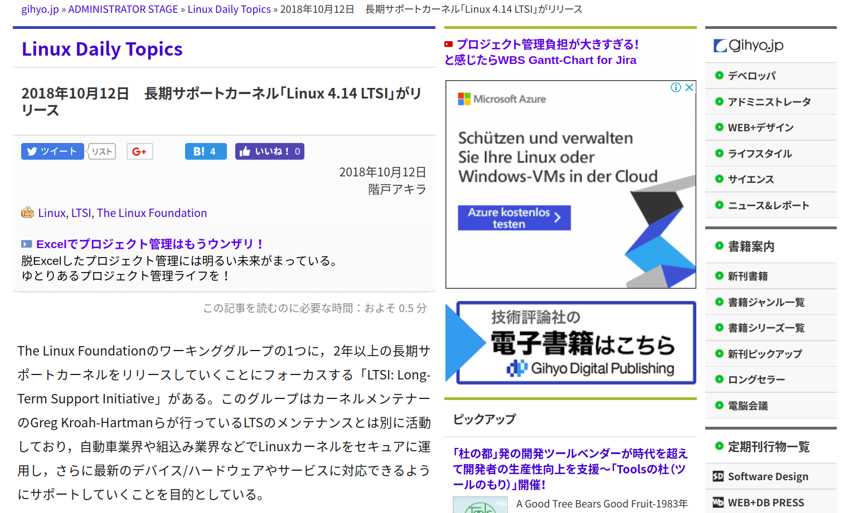
update
https://gihyo.jp/admin/clip/01/linux_dt/201810/12

Slide 31
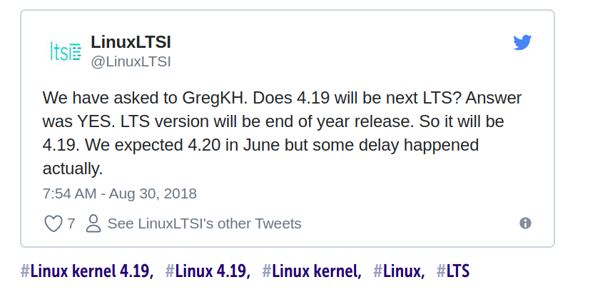
LTS/LTSI for 2019 will be 4.19
update

Slide 32
Conclusion
Using LTS/LTSI is important for real use case
Security fixes are more important and apply ALL the LTS patches may be a solution
  Continue to discuss for a better shape
Why don’t you join LTSI?
  By joining LTSI, you will be able to share best practice
  Be able to get information for stable kernel

Slide 33

You can participate LTSI
Follow on Twitter account:
@LinuxLTSI
Web:
http://ltsi.linuxfoundation.org
Mailing list:
https://lists.linuxfoundation.org/mailman/listinfo/ltsi-dev
Git tree :
http://git.linuxfoundation.org/?p=ltsi-ernel.git;a=summary
<番号>
Notes:
<番号>

Slide 34
THANK YOU
<番号>
Notes:
<番号>

