Slide 1
JTAG ICE
PARTNER-Jet
Kyoto Microcomputer Co., Ltd.

Slide 2
About Kyoto Microcomputer
Founded in 1985 - KMC has been working in embedded debugger field for more than 20 years.
Has very success in Japanese embedded debugger market.
Shipped 5000 units of PARTNER-Jet within 4 years in Japan.
President & CEO | Syoichi Yamamoto
HQs Branch Distributors | Kyoto, Japan Tokyo, Japan India, Korea
Primary Products | JTAG ICE “PATNER-Jet” Windows Native GCC “exeGCC C/C++” Evaluation board “KZM-ARM11-01”

Slide 3
Environment of
Embedded Device Development

Slide 4
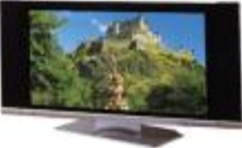
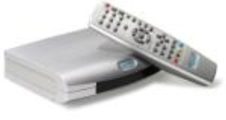
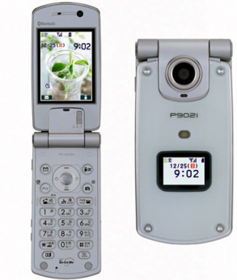
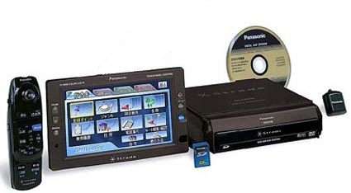
KMC’s Target Application
Digital Home Appliance
  Digital TV, DVD recorder, STB…
Imaging
  Color Laser Printer, Multi-functional Printer,
  Digital Still Camera, Digital Cam Coder
Communication
  Smart Phone
Multi-media
  Car Navigation System, Personal Audio Player

Slide 5
Requirements for Debugger
Wide range of processors support
  ARM, MIPS, SH,PPC &PPC…
New technology support
  Multi-core, SMP…
High-speed transfer for large program & data
  Fast writing Large volumes data to FLASH
  Broad range of FLASH support
OS support for Linux, Windows CE ,T-Kernel etc.
  MMU support
  Process-aware & Thread-aware debugging and Performance analysis support

Slide 6
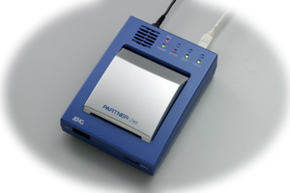
Features of PARTNER-Jet

Slide 7
Requirements for Debugger
Broad range of processors support
Realizes High-speed transfer for large program & data
Enables Large-scale OS debugging
  Linux
  Windows CE
Provides sophisticated features and stress free debugging
  Multi-core support, Profiling

Slide 8

ARM Support
Supports wide range of ARM processors
  ARM 7TDMI, ARM 720...
  ARM 920, 922, 925, 926, 946...
  ARM 1136,1176,1156,MPCore
  ARM Coretex-A8
Supports ARM V4, V5, V6 and V7 architectures
Supports Thumb/Thumb2 code and VFP/neon
Supports ETM/ETB
Supports ARM RVDS, GNU C, exeGCC compiler
Supports MultiCore and SMP
Excellent Linux supports
T-Kernel supports
Windows CE supports

Slide 9

Renesas SuperH Support
Has very good relationship with Renesas
Supports wide range of SuperH processors
  SH2, SH2A series
  SH3, SH3DSP series
  SH4, SH4A series
  SH-Mobile series
Supports H-UDI/AUD trace
Supports MultiCore and SMP (SH2A DUAL/SH7786)
Supports SuperH C/C++, GNU C, Green Hills C, exeGCC compiler
Excellent Linux supports
T-Kernel supports
Windows CE supports

Slide 10

MIPS Support
Has very good relationship with MIPS Technologies, Inc.
Supports wide range of MIPS cores and processors (over 34 MPUs)
  MIPS32 4Kc, 4KEc, 24Kc, 24Kf
  NEC EL EMMA Architecture, Vr series
  AMD Alchemy
  Toshiba TX series
Supports MIPS32 Release 2 instruction sets
Supports GNU C, Green Hills C, exeGCC compiler
Supports 64 bit register
Excellent Linux supports
T-Kernel supports
Windows CE supports

Slide 11
High-speed transfer for large program & data
High-Speed download
  3.3Mbyte/sec
  Linux Kernel Downloard
    Approx. 3.5Mbyte Approx. 1 sec.
  Windows CE Image file includes file system
    Approx. 32Mbyte Approx. 10 sec.
Writing to NOR FLASH
  With 4Kbyte target memory
    1Mbyte 13 sec.
  Without target memory
    1Mbyte 20 sec.
  Linux XIP Kernel Write 30 sec. to 50 sec.
Step Execution
  100 steps Less than 2 sec.
  Target CPU:VR5500A JTAG Clock 57.75MHz

Slide 12


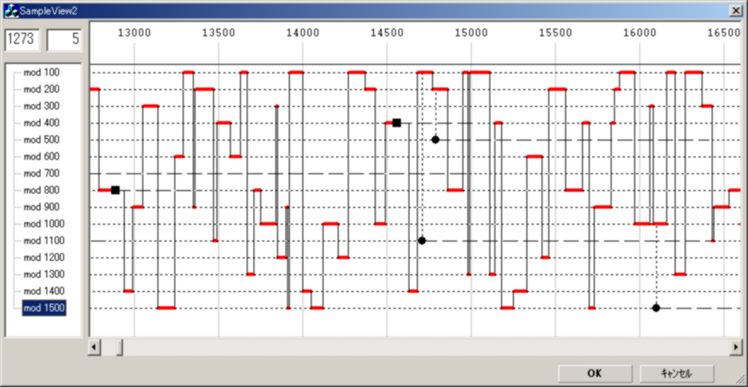
Realized Large-scale OS Debugging
Linux Debugging Support
  Already released
  kernel-2.4x, kernel-2.6x
Windows CE Debugging Support
  Already released
  Windows CE 5.0, Windows Embedded CE 6.0
OS aware Debagging & Parformance Analisys
  Linux,T-Kernel,ITRON

Slide 13
Stress-free Debugging on Linux
Supports Linux2.4x, 2.6x
Supports major Linux distribution
  Montavista Linux, Lineo uLinux…
Utilize ICE original features
  Hardware break
  Real-time trace
    Can sort the trace by kernel and process
  Writing to Flash memory
Loadable module Debugging
  Automatic read/Automatic relocation of debug information
Multi-process, Multi-thread support
  Can attach to the running process and thread
  Supports Shared library Debugging
    Automatic read/Automatic relocation of debug information
  Supports application mode which doesn’t stop except the target thread for debugging

Slide 14
I want to use a debugger when…
Debugging both application and drivers simultaneously.
Solving the problem by analyzing CPU execution trace.
Debugging interrupt handlers from bottom to top.
Debugging initiate process of Linux.
Debugging XIP kernel.
Debugging programs even when the kernel and/or drivers are freeze.
Debugging the sequence(s) between processes.
Debugging completely of Multi-thread and Multi-process
  Multi-process and Multi-thread debugging in ptrace() is incomplete.
Catching specific memory-write action in specific process.
Debugging target without consuming resources (RAM etc).

Slide 15
Stress-free Debugging on WinCE
Supports Windows CE 5.0, Windows Embedded CE 6.0.
Can source code debugging on Windows CE by ICE.
  Boot loader (EBOOT), Kernel (Shared Source), Driver, User application
Can debug the final product software generated by Release Build.
Fast pace debugging is possible with actual running speed without any system load.
No connection other than JTAG is required.
Can use debugger from Visual Studio 2005 by supporting eXDI2

Slide 16
Comparison of WinCE Debugging
 | Kernel Debugger | Application Debugger | eXDI and H/W Debugger | PARTNER-Jet
Debugging Boot loader
Debugging Device driver
Debugging Application
Consuming ROM/RAM by Debugger | ROM/RAM | RAM | ROM/RAM | None
Execution load by Debugging | medium | medium (CE6.0) large (CE5.0) | medium | small

Slide 17
Multi-core Debugging
Expanding utilize the Multi-core Soc.
  Keep Low power consumption and High performance.
  Reduce the cost by combining cores into 1 chip.
Share terminal for debugging among cores.
  Terminals on SoC is very important resource, so cannot use many terminals for debugging.
  Each core is connected to JTAG chain by cascading
Need Multi-core supported debugging tool
JTAG access performance is reduced due to cascading connection.
  2 core cascading connection reduces 30% of speed compare to 1 core.
Need more High-speed JTAG ICE

Slide 18
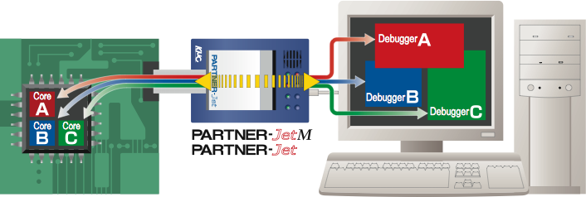
Multi-core Debugging
Shared a single JTAG connection among the cores
High-speed exclusive control of JTAG signal
Can debug independently by each core or in cooperation with cores.

Slide 19
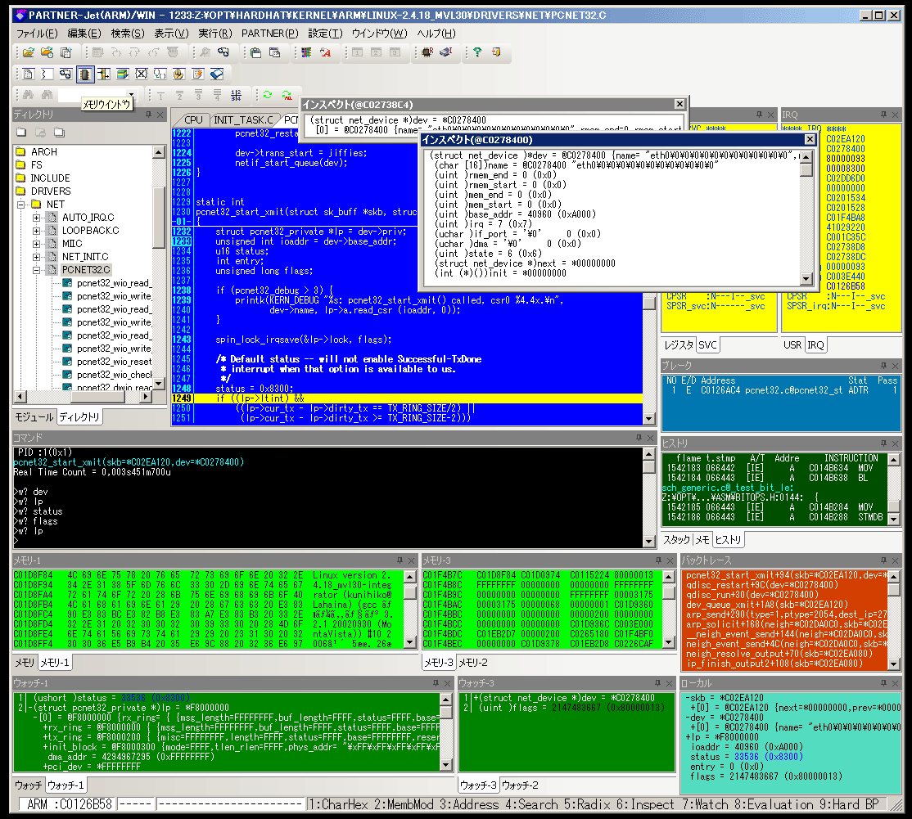
Stress-free Debugger U/I
Capable to handle over 100MByte of ELF file.
  Build a huge application with debug information made100MByte ELF file.
Can load over 100 of ELF files.
  e.g. Shared library was mapped over100 in a Linux application.
Handling large volumes
information.
  High-speed analysis of
  debug information
  Simple search function
  Can set break points from
  the tree view directly in case of
  a top of a function.
  Collaboration of GUI and CUI
  Fast step execution & Fast
  memory display
  Customizable debug features

Slide 20
Requirements for Debugger
Wide range of processors support
  ARM, MIPS, SH…
New technology support
  Multi-core, SMP…
High-speed transfer for large program & data
  Fast writing Large volumes data to FLASH
  Broad range of FLASH support
OS support for Linux, Windows CE etc.
  MMU support
  Process-aware & Thread-aware debugging and Performance analysis support
20

Slide 21
Ideal for large-scale project
Wide range of processors support
  Supported CPU list, check http://www.kmckk.co.jp/eng/
  Latest processor support by debugger soft update
  For more information, please ask our distributor or KMC
Highspeed download
  3MByte/sec via only uses JTAG
  It is capable highend application.
OS support
  Complete source code debugging is possible from kernel to application by a single PARTNER-Jet even if Large scaled OS such as Linux and Windows CE
Great help for the bring up period and bug fix before shipment.

Slide 22

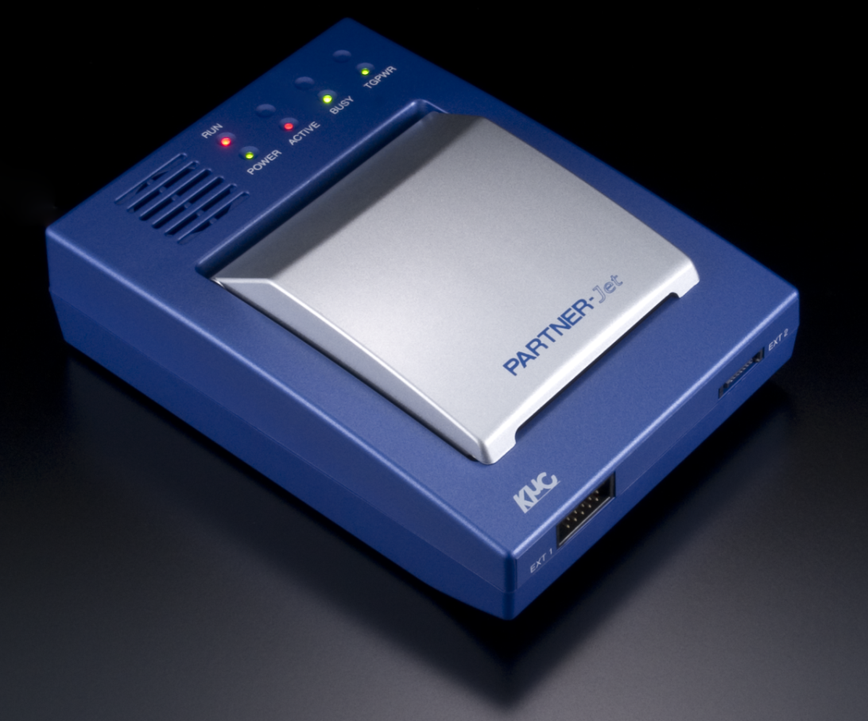
Sophisticated Debugger

Slide 23
Contact:
  Kyoto Microcomputer Co., Ltd.
    Email: en-info@kmckk.co.jp
  URL:http://www.kmckk.co.jp

