Slide 1
Best practice of Open Source Operating system adoption
How to realize high-quality, availability and maintainability
Hisao Munakata
Automotive Information Solution division,
Renesas Electronics Corp.

Slide 2
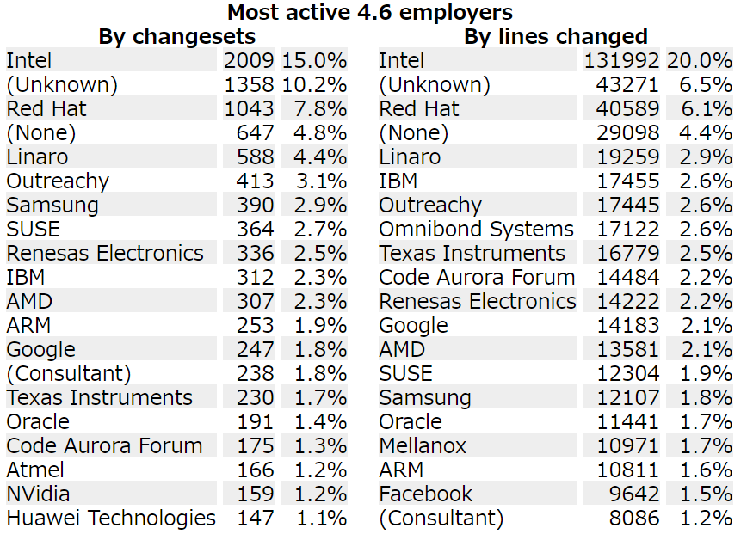
Who am I
From automotive target SoC provider company Renesas.
Leading Linux kernel upstream development team.
AGL (Automotive Grade Linux) advisory board member.
LTSI (longterm kernel) and yocto (build tool) project board member.
Latest Linux kernel contributor company ranking
https://lwn.net/Articles/686393/

Slide 3
Agenda
Software structure of IVI (In Vehicle Information) system
  IVI software trend and architecture
  RTOS vs. Linux philosophy comparison
  Challenge of connected car software
The fact of Linux kernel
  Linux kernel summary
  development community
  Transparency and openness of OSS development process
OSS adoption challenge for IVI system
  Code quality
  Security risk management

Slide 4
Agenda
Software structure of IVI (In Vehicle Information) system
  IVI software trend and architecture
  RTOS vs. Linux philosophy comparison
  Challenge of connected car software
The fact of Linux kernel
  Linux kernel summary
  development community
  Transparency and openness of OSS development process
OSS adoption challenge for IVI system
  Code quality
  Security risk management

Slide 5
Linux becomes de-facto OS of connected Car
internet,
file share
 | 1980 - 2000 | 2000 - 2013 | 2013 -
IVI application
Software structure
generations | Gen.1 (standalone system) |  | Gen.2 (connected)
Navigation (map display, drive route guidance)
Multimedia (sound, video)
Smartphone link
Internet application
Monolithic
software
(RTOS base)
IVI applications
IVI applications
Automotive OS
(Windows Auto, QNX,..)
Middleware
Linux kernel
General purpose OS adoption

Slide 6
Why OSS becomes common choice?
software
Differentiator technology
Human Machine Interface
modern trends
Custom application
Application runs on
a proprietary
software framework
Linux OS kernel
Network connectivity
Storage device support
Security framework
Graphics framework
Java, multi-core CPU
O
S
S
non-differentiator
common technology
portion is getting bigger
simple monitor program
non differentiator technology
Simple micro-processor
complicated device
manipulation needed
High-performance SoC
（multi-core, Graphics)
hardware

Slide 7
Construction of Linux based software (AGL example)
automotive
OS / common
connectivity
Graphics
Navi / LBS
multimedia
Native app.
AGL app fw
Web app fw.
AGL
App.
FW
Window mgr
sound mgr.
native app
framework
App mgr.
Web API
native app runtime
Policy mgr.
Web runtime
Speech service
Security
Input mgr.
user mgr.
Auto-
motive
Service
Vehicle Bus
PIM
smartphone
navigation
service
multimedia
Diagnostics
telematics
audio service
configuration
tuner service
Camera
Lifecycle mgt.
bluetooth
Graphics
location
service
Platform
Service
network
WiFi
window system
error mgt.
telephony
power mgt.
resource mgt.
IPC
Health mon.
Linux kernel
kernel
Hypervisor
boot loader
resource ctrl
startup / shutdown ctrl
system
updates
peripherals
graphics
video
audio
automotive
devices
device
drivers

Slide 8
RTOS vs. Linux : completely different philosophy
Traditional RTOS programing manner does not work for Linux environment.
RTOS (monitor program) | comparison items | Linux
sequential execution | task execution order | runtime auto coordination
fixed by coding (deterministic & predictable) | scheduling policy | smart & fair CPU allocation (heuristics)
static allocation (pre-assigned) | resource allocation | dynamic (runtime allocation)
absolute address | address description | relocation address
No | address translation | Yes (by MMU)
Yes | realtime management | No (various cache mechanism)
No | multi processor | Yes (SMP, AMP, HMP)
No | virtualization | Yes
Yes | FUSA support | No

Slide 9

Evolution of software development model
field update
becomes
mandatory
multiple iteration
code freeze
at the production
maintenance update after shipping
maintenance update after shipping
maintenance update after shipping
Requirement collection
Spec definition
Coding
Requirement
collection
Spec definition
Coding
Test and
system validation
Test and system validation
Traditional water flow development model
Agile software development model

Slide 10
Agenda
Software structure of IVI (In Vehicle Information) system
  IVI software trend and architecture
  RTOS vs. Linux philosophy comparison
  Challenge of connected car software
The fact of Linux kernel
  Linux kernel summary
  development community
  Transparency and openness of OSS development process
OSS adoption challenge for IVI system
  Code quality
  Security risk management

Slide 11
Fact : Linux kernel version 4.6 (released 2016.5.15)
Linux kernel is huge, the work result of 25 years continuous development effort.
No single company can compete with this development power (speed and quality) .
item | data
SLOC (true Source Lines Of Code) | 14,398,866 line
v4.5 to v4.6 SLOC delta | 279,351 line
v4.5 to v4.6 update period | 73 days
Average update cycle | around 70 days
Source code file number | 42,236 files
merged commits | 13,354 pcs
Contributed developers count | 1,661 mans
Value estimation (by sloccount) | $627,894,993 (≒ 690 oku-yen)
kernel 4.6 release info : https://lwn.net/Articles/686393/
kernel 4.6 feature intro : http://kernelnewbies.org/Linux_4.6

Slide 12
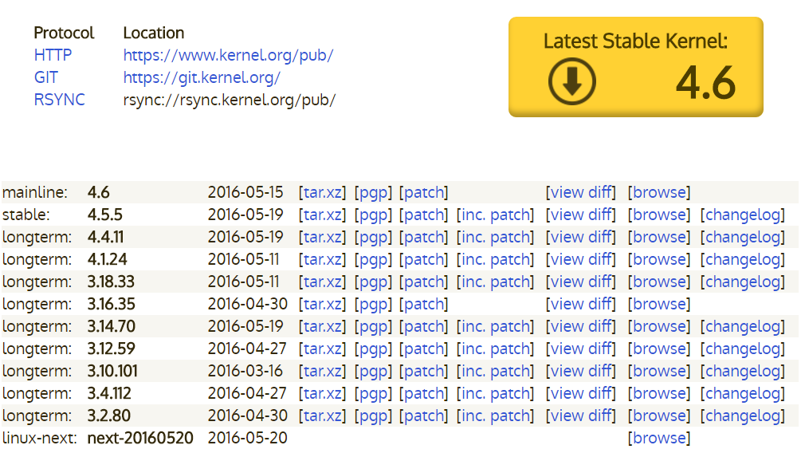
www.kernel.org : heart of Linux kernel development
①
②
①：Latest release
②：under development
③：long-term
④：queued for the next
③
④

Slide 13
Community gathers best of best talented developer
software development team @company A
software development team @company C
development
community
sub
lead
lead
lead
sub
lead
lead
Neither a hobbyist nor academic. Each company send their best developers to the community.
sub
sub
software development team @company B
software development team @company D

Slide 14
Serious battle to get next-gen technology standards
next-gen technology trends decided by
the community work
Company A
demands
development
community
technology follower’s burden
Company B
demands
A
D
B
E
lead
C
sub
Company C
demands
free rider company
bears the burden of chasing new trends
next-gen technology trends decided by
the community work
Free rider
company

Slide 15

Layered structure of maintainer : trusted link
Linus Torvalds
Review and merge request
pull request
sub-system
maintainer
sub-system
maintainer
sub-system maintainer
about 1,800
maintainers
driver / file
maintainer
driver / file
maintainer
driver / file maintainer
driver / file maintainer
user / developer
user / developer
user / developer
user / developer
user / developer

Slide 16
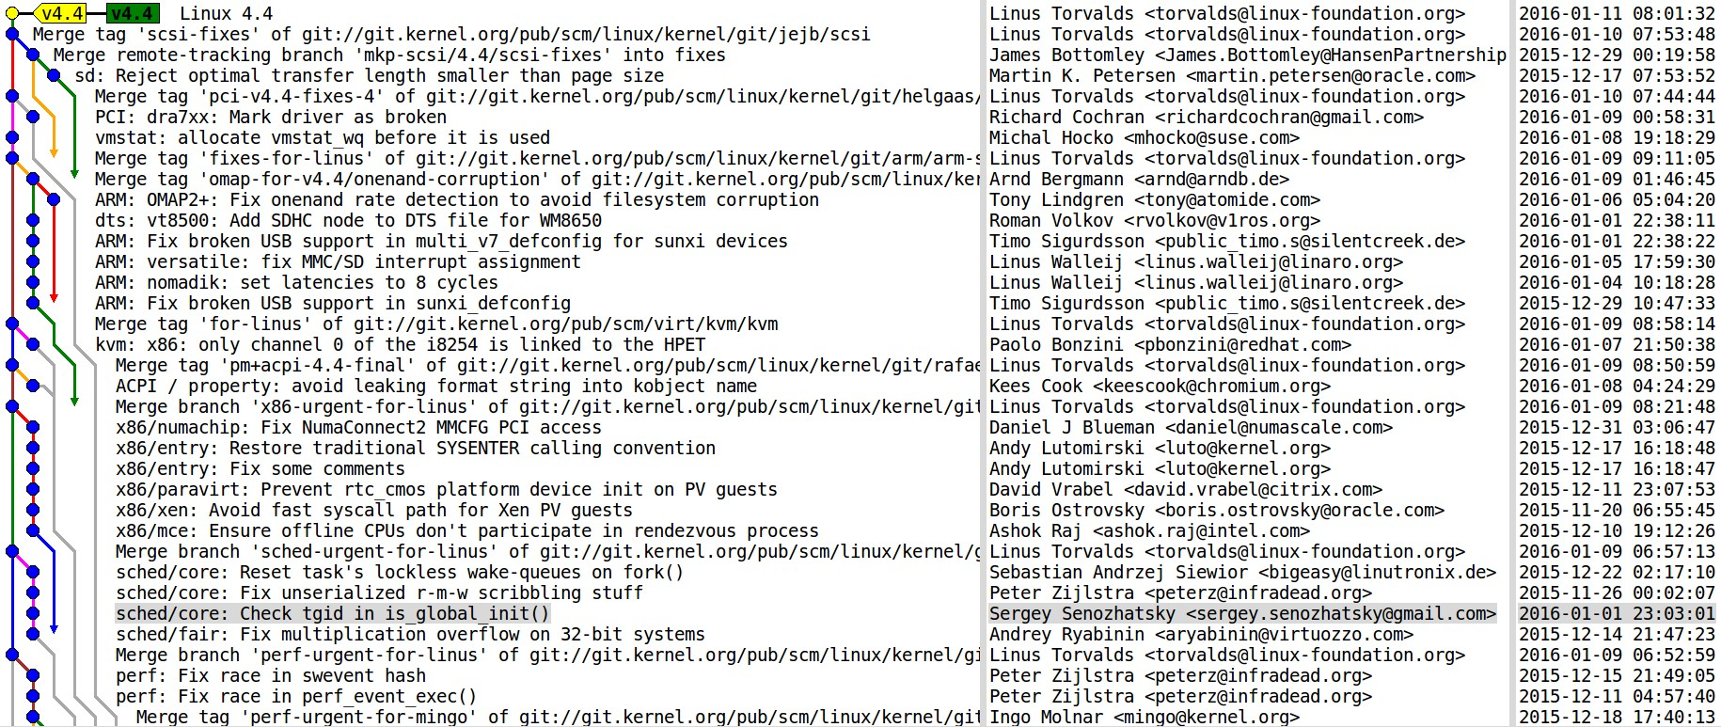
git : advanced code management system (= CMS)
Linux kernel consist of small code chunk named “patch” submitted by the developers.
git support distributed code development
and automated code integration & review
mechanism. Each developer can send small
code chunk named “patch” to create Linux

Slide 17
“public patch review” is the key success procedure
Do not send a completed code,
but just idea and
small chunk piece
public mailing List
Iteration 3 ~ 10 times
IDEA
RFC
Patch
submission
Patch
improve
Linux
next
mainline
subsystem
tree

Slide 18
Constant kernel version migration process
Linux next
constant release at around every 70 days
merge window
validation period (rc1 to rcX, likely 8 or 9)
around 2 weeks
around 7 or 8 weeks
kernel 4.6
release
4.7-rc1
4.7-rc2
4.7-rcX
kernel 4.7
release
Patch merge period starts right after new version kernel release, and last 2 weeks.
After merge windows close, multiple validation release (rc1 to rc8/9) continues
Linus keeps same release interval of around 65 days.

Slide 19
Agenda
Software structure of IVI (In Vehicle Information) system
  IVI software trend and architecture
  RTOS vs. Linux philosophy comparison
  Challenge of connected car software
The fact of Linux kernel
  Linux kernel summary
  development community
  Transparency and openness of OSS development process
OSS adoption challenge for IVI system
  Code quality
  Security risk management

Slide 20
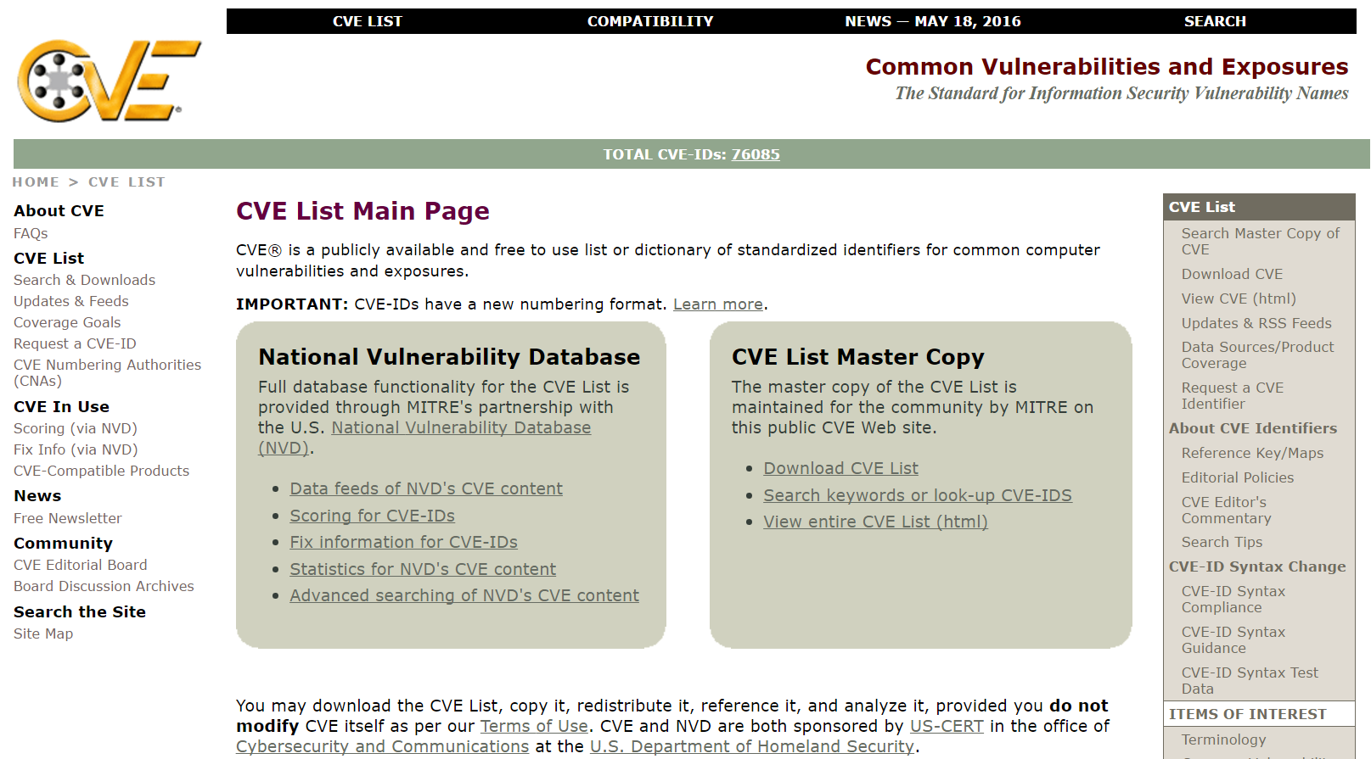
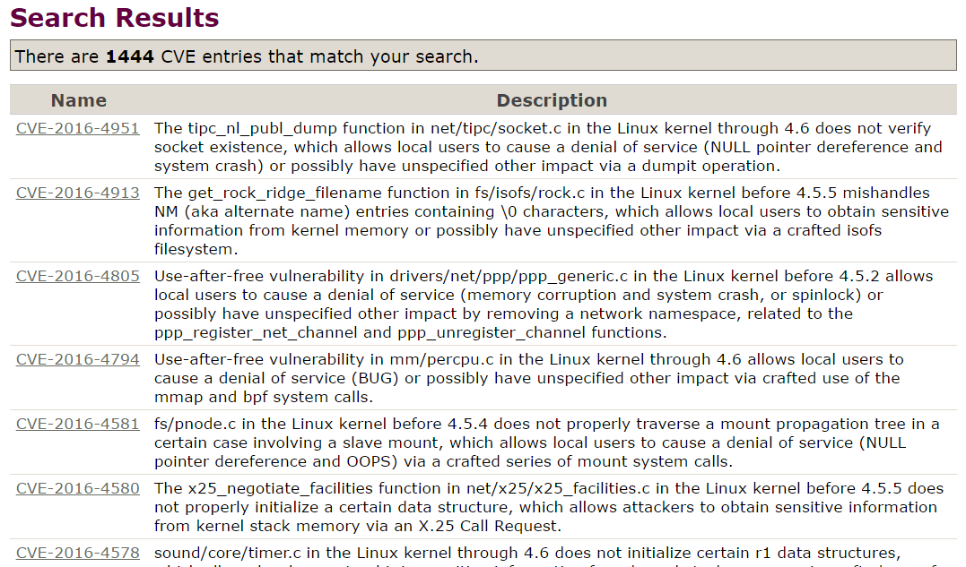
Software vulnerability (CVE list) risk
https://cve.mitre.org/cve/index.html

Slide 21
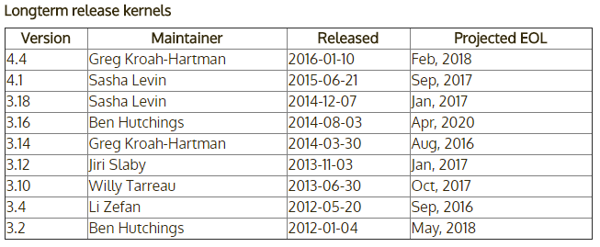
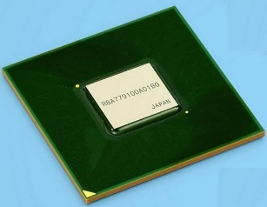
Longterm kernel contains many CVE fix patces
LTS | kernel | release | latest | patch
 | 3.9 | 04.28.13 | 3.9.11 | 746
* | 3.10 | 06.30.13 | 3.10.101 | 5,388
 | 3.11 | 09.03.13 | 3.11.10 | 677
(*) | 3.12 | 11.15.13 | 3.12.60 | 6,412
 | 3.13 | 01.21.14 | 3.13.11 | 903
* | 3.14 | 03.30.14 | 3.14.70 | 4,696
 | 3.15 | 06.08.14 | 3.15.10 | 703
 | 4.0 | 04.12.15 | 4.0.9 | 757
* | 4.1 | 06.21.15 | 4.1.25 | 2,499
 | 4.2 | 09.01.15 | 4.2.8 | 903
 | 4.3 | 11.01.15 | 4.3.6 | 618
* | 4.4 | 01.10.16 | 4.4.11 | 1,145
Selected kernel version named “longterm-stable (LTS)” kept maintained with a collection of security fixes.
Gen2 BSP
gen2 device
gen3 device
https://kernel.org/category/releases.html
aiming 2017 LTS version kernel (4.7?)
Gen3 BSP

Slide 22


Connected era’s quality : changing the scheme
maintenance update
maintenance update
maintenance update
maintenance update
Analysis
Spec
Code
Analysis
Spec
Code
Test
Test
Validation
+
Quality =
maintenance
management
Requirement
Quality =

Slide 23
Upstream first strategy
rc-1
rc-1
rc-1
4.5
4.6
4.7
4.8
4.9
review & merge
new
code
BSP
base
code
patch submit and get community review
backport from mainline merged code
pros. | cons.
Can develop clean code by community review | It takes time (up to 6 month to merge)
Merged to the mainline, no more in-house code | Can not hide your secret (=differentiator)
Can apply upstream security fix patch | You may need to rewrite the patch by review

Slide 24
CI : Continuous Integration and many release
4.5
push out not fully
validated code to
the next release
4.6
4.7
“CI” becomes mantra for
complexed software development
consistent
consistent

Slide 25
Conclusion
Linux and other OSS adoption become dominant for connected car IVI systems. (network, file system, security, graphics)
Traditional RTOS development model does not work for Linux.
You need to learn how OSS community develops the code. And
write the appropriate code that complies with Linux philosophy.
IVI system needs to have a field software update feature to apply
CVE fix patches come from the community. If you heavily modify the code, it may cause security patch adoption troubles.

