Slide 1
Close Encounters of the Upstream Resource
HISAO MUNAKATA
RENESAS SOLUTIONS CORP
hisao.munakata.vt(at)renesas.com

Slide 2
who am I
Work for Renesas (semiconductor provider)
  Over 15 years “real embedded Linux business field” experience
  Providing “free Linux starter code (BSP)”
  We help our important customers who are Linux newbie's.
  ( They ask anything about Linux to us. )
  Over 5 years experience working with the community
  Linux Foundation CEWG Architecture group co-chair
  I am leading Linux core technology team in Renesas that develops upstream Linux code. As this team consisted of several community developers we had chance to work closely with Linux upstream.
We are learning how to work with the Linux community

Slide 3
My FINDINGS

Slide 4



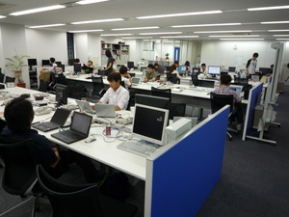
“production team” vs. “evolution team”
community, long-term, reusable code,
no appointed date of delivery
upstream
community
“utopia”
“red party”
product developer
“blue party”
upstream developer
office
“business”
budget, mass production, competition

Slide 5




Each party aims different goal
too short focused “easy” solution
A code reuse rate is low
No intention for open source contribution
lack of feedback ( requirement, bug info )
random requirements
development takes too long time
maybe lack of stabilization
hard to make product differentiator
can not help today’s release
unclear support scheme
Each party aims different goal and it seems very hard to share it.
However red party’s (future) work depends on blue party anyway.

Slide 6

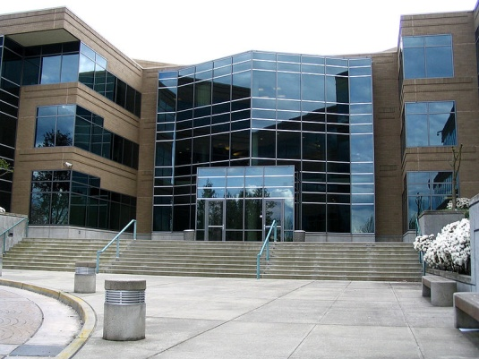
Red team development system at the time of “binary-only world”
authorized integrator
binary
code delivery
license fee
contract based
paid support
There were no chance (demand) to access source code. They could ask paid support to get workaround, but it was not a true solution.

Slide 7

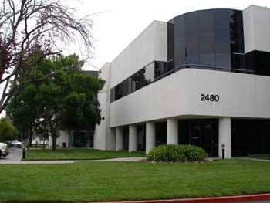

Red team development system
at the time of start using Linux for CE products
source code
embedded Linux
distribution
source code
integrated BSP
paid support
almost no interaction
Industry developers were mainly supported by embedded Linux distribution and/or integrator company. Due to kernel version gap, there were very limited connection to the upstream community.

Slide 8






Red team development system
at today ( start adopting community framework )
They work closely
upstream
community
industry
consortium
Industry developers have started to adopt relatively new kernel that have been integrated in software platform. However they are not familiar with working with the upstream development community.

Slide 9
struggles of production Team

Slide 10




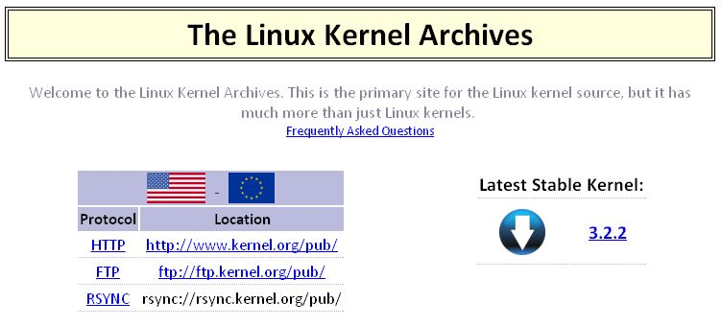
tend to develop own unique kernel
struggles 1
hard to mainline
too unique code
x
upstream
community
You are allowed to modify source code as you like, BUT…

Slide 11







incorrect way of patch creation
struggles 2
Linux has been constructed as accumulation of a degradable small patches.
patch
patch
Driver code for specific environment that is not abstracted.
Does not work with SMP
incorrect use of kernel API
non-portable coding
too big piece hard to merge
duplication of code
missing git log information
wrong patch format
Locally developed large & irregular patch can not be integrated

Slide 12




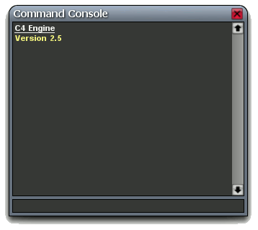
lack of elemental modern OS understanding
struggles 3
everyday
till mid-night
# kernel panic !!
# crush dump XXXX
# segmentation fault
When they faced a problem of the Linux origin,
they think they can be settled in oneself. However ,...

Slide 13



emergency support request may not work
struggles 4
pointless log gathering
log
non-essential guide

Slide 14





re-inventing already created bug-fix
struggles 5
bug fix
bug fix
fix already exist in
new kernel code
creating in-house fix
upstream
community

Slide 15








mindless patch merging without inspection
struggles 6
incompatible code
binary driver
code that include bug
They really do not understand the role of tree maintainer

Slide 16


long term maintenance of in-house orphan tree
struggles 7
locally developed
in-house code, that
could not be merged
back to the upstream
It costs enormous expenses for the lone tree maintenance.

Slide 17
do the right thing with the community resource

Slide 18

As you start using fresh kernel, community became close
Linux 2.6.32
They had been completely isolated
(due to the kernel version gap)
2.6.18
getting
closer
upstream
community
Linux 3.3
Linux 3.0
Resources of the upstream community are more available till now.

Slide 19

Even if you are not a upstream developer,….
I know production developers are extremely busy with their own target development, and I do not demand the following thing.
  check all community ML discussion relating to your topic
  create patch against current upstream development kernel
  negotiate in ML discussion to merge your patch to the upstream
If you can pay more attention to existing
open source community resources like
git, BTS, ML and others, you may utilize
them to make your development more
efficient and clean. So this is the right time
to breakout to the open source arena.

Slide 20



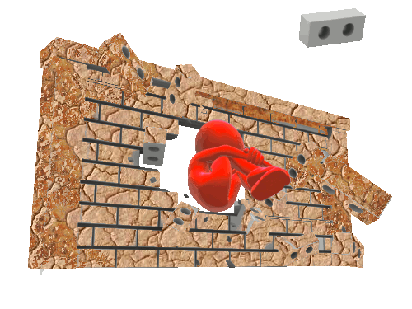



Breakout to the community resource !
developer
network
upstream
community
code repository
ML archives
code archives
consortium
Even without direct contribution, red team developer can utilize various “open resources” to manage better work !!

Slide 21

several recommendations
“git”
utilization
allocate
appropriate maintainer
red & blue coordination
BTS contents
disclosure
Linux built-in
tool utilization
“LTSI”
as common ground

Slide 22


recommendation 1
correct use and utilization of git
Git is extremely powerful code management tool. Correct and efficient use of git is essential to improve your development.
You should add correct git log message to all codes you add.
Source code must be tie with .git repo management information. This will dramatically reduce future debug and maintenance cost.
If you develop Linux/Android code, you can always compare
your code and current latest community code. It will show how
community modified (polished) the upstream code. And their code might already include the code you need to develop.
You can create any experimental branch with git.
And you can merge it to the original tree when it is
enough verified. Creation of random experimental
branch without git use easily makes spaghetti code.

Slide 23
Example 1
kernel bug-fix patch cherry picking
Determine potential problematic area by locating commonly used functions in function call history included in error log messages
Use git to check which bug fix commits that are included in latest stable tree update for the problematic area http://git.kernel.org/?p=linux/kernel/git/stable/linux-stable.git;a=summary
Use git to check new commits in latest upstream tree for the problematic area, maybe bug fixes are missing from stable? http://git.kernel.org/?p=linux/kernel/git/torvalds/linux-2.6.git;a=summary
If no potential fixes exist in stable or latest upstream then give up
If fixes exist then create custom back port with multiple commits covering the problematic

Slide 24
Example 1
kernel bug-fix patch cherry picking (cont’d)
Test the custom back port and keep your fingers crossed
If problem disappears then adjust back port to become smaller
to work towards locating actual fixes
If problem still exists then make back port larger to cover greater area to include more potential fixes
Repeat testing and adjustment of back port until satisfied
or giving up
Contact stable maintainer to discuss inclusion of fix in
next stable release

Slide 25
Example 2
Android version comparison
You can download Android platform source code (except 3.x series) from AOSP repository. And fortunately AOSP code includes git management information, you can compare your code and AOSP latest code pretty easily. So if you are stuck with any Android platform related problem, it is good idea to check this first to notice Android upstream work result as it may already include solution for your problem.
Furthermore, you can compare the cord of the latest Android 4.0.x series with the cord of the Android 2.3.x series. This may help you when you want to add SMP support upon 3.2.x environment.
You need to become professional user of repo and git command to perform efficient code comparison.

Slide 26
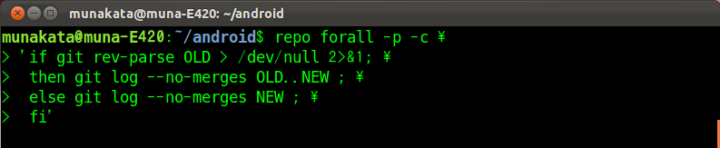
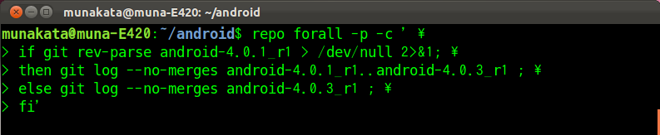
Example 2
Android version comparison (cont’d)
You can compare OLD and NEW with following repo command.
This will show anything modified from OLD -> NEW and newly
added stuff on NEW.
Sample to compare android-4.0.1_r1 and android-4.0.3_r1

Slide 27
Example 2
Android version comparison (cont’d)
To deep dive into each change, initially you need to move to each source directory and use git log command with appropriate option. Here listed some useful git log option.
  --grep= 'keyword’
    Set to find log including ‘keyword’
    You can find patch including the work “LTE” by setting --grep='LTE'
  --author='author’
    Set to find log that has ‘author’ in Author
    You can find commit made by Samsung with setting author='@samsung.com'
  -p : generate patch form output
  -E : accept Extended regular expression

Slide 28
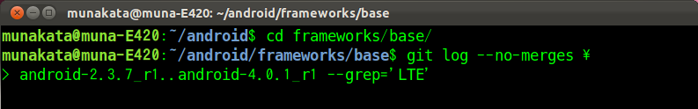
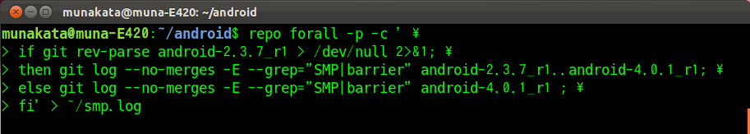
Example 2
Android version comparison (cont’d)
If you want to find the change between android-2.3.7_r1 to android-4.0.1_r1 that include keyword “LTE”, you can use following command.
Last example is a bit advanced one. This will show android enhancement between 2.3.7_r1 (GB) to 4.0.1_r1 (ICS) to add support for SMP processor.

Slide 29






recommendation 2
Placing maintainer who owns strong practice authority
All patches must be investigated thoroughly before merging it,
and this is the process that is essential to avoid tree confusion.
The tree maintainer needs to block all inappropriate code. Therefore he must have strong authority. It may be too hard for
junior engineer.
in-house tree
maintainer
ugly
patch
Maintainer need to reject any request that include bad code.

Slide 30




recommendation 3
red team and blue team coordination
The perspective of the blue team is totally different from the red team. However, it is useful for both sides to share the demand of the red team. This can be a trigger to add industry demand into future kernel.
demand
list
upstream
task list
production
task list
Red team can share production team demands to Blue team

Slide 31


recommendation 4
Disclosure of red team BTS contents
Community development takes time as it will require coordination.
Product development always requires immediate bug-fix.
Therefore it does not make sense to use single BTS for both party
However,… The same problem will occur again if they do not add
bug-fix code to the community upstream. So bug information share between production(red) and upstream(blue) team would be beneficial way.
bug
report
production
BTS

Slide 32

recommendation 5
“LTSI” as common ground
upstream
latest
LTSI
integrated
vanilla
kernel
community
long-term
stable
feature
backport
from new
kernel
SoC
vendor
Tree
Android
AOSP
CEWG
project
upstream
long-term
4way merge
process needed
Project code
“AOSP” etc.
SoC vendor
in-house tree
Champagne 17:15 Wednesday, February 15th
“On The Road: To Provide the Long-Term Stable Linux For The Industry”
LTSI is Linux Foundation project to provide integrated stable kernel

Slide 33
Conclusion
It is a very good trends that product development team come to use relatively new kernel because it shorten the distance to the upstream community.
However, it does not seem to be able to be understood how the production developer can utilize the published community resources.
It is understandable that production development team prefer their own way of development. However it is essentially important to study and adopt already proven open source development process, e.g. “full utilization of git”, “adoption of Linux upstream code review process”.

