Slide 1
Traditional system validation methodology will not work for connected-car
- Learn from the computer history -
Hisao Munakata
.
Linux Foundaton, board member
Automotive Grade Linux, Advisory board
Senior Director, Renesas Electronics Corp

Slide 2
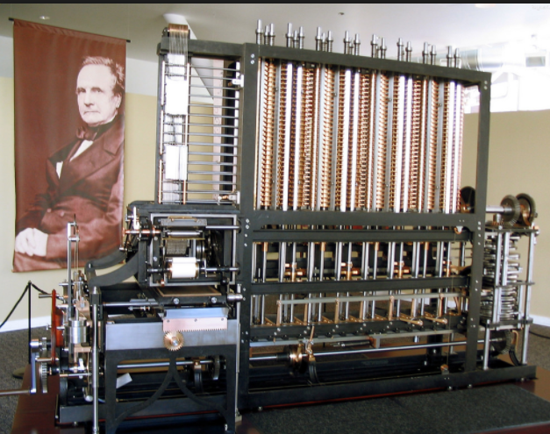
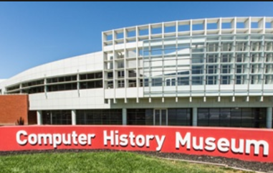
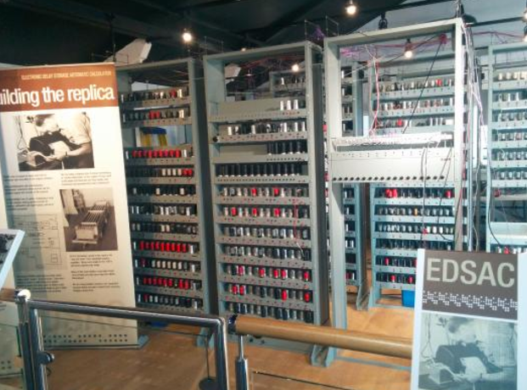
Computer history
100% mechanical
ENIAC (1946) : World first well-known “computer”
EDSAC (1949) : World first computer that runs “program (software)”

Slide 3
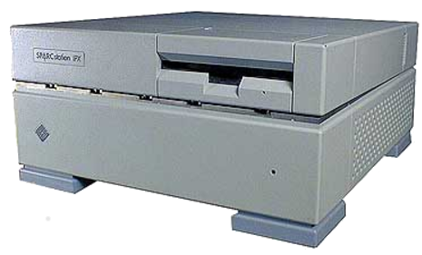
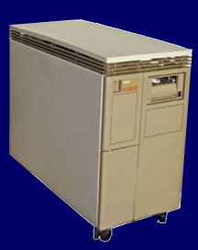
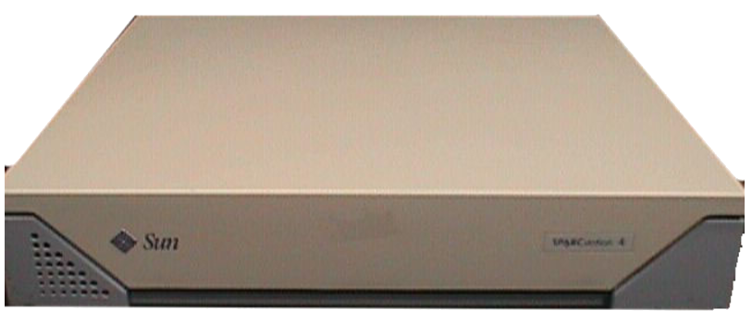
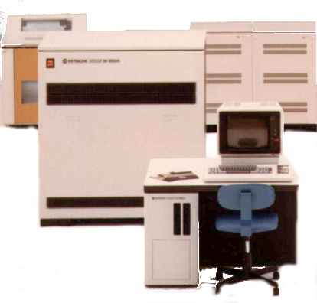

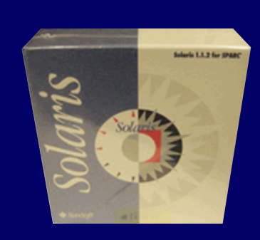
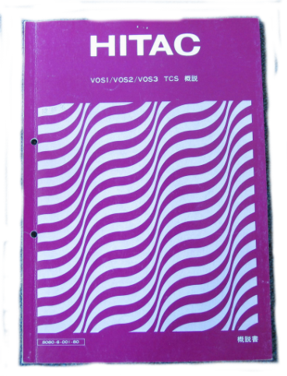
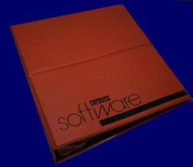

Computer used to come with dedicated software
SUN 4C/50
(2000)
SUN SS4
(1997)
DEC
MicroVAX2
(1985)
3rd party OS
HITACHI
HITAC M280H (1983)
1998
1991
Linux development
for Sparc4c

Slide 4
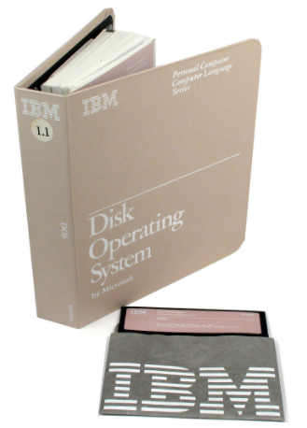
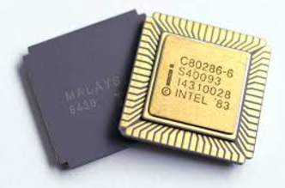
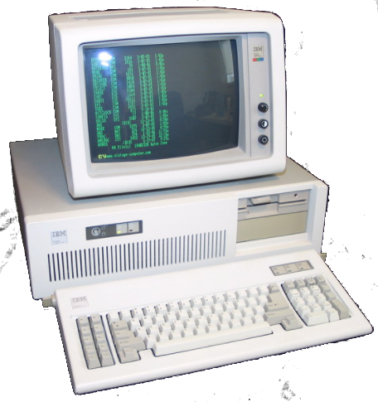
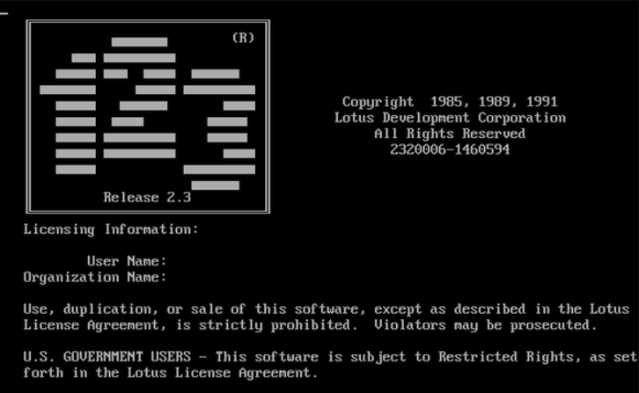
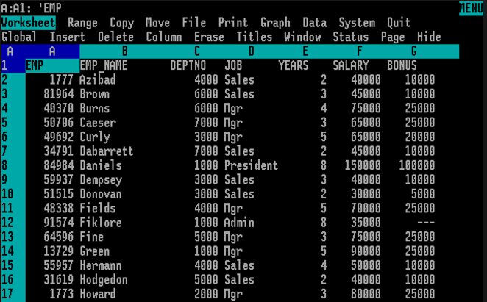
Personal computer (early days)
IBM PC-AT (1984)
IBM provided
PC-DOS
PC manufacturer
can validate whole
system integration.
(HW+CPU+OS+APP)
Limited application

Slide 5

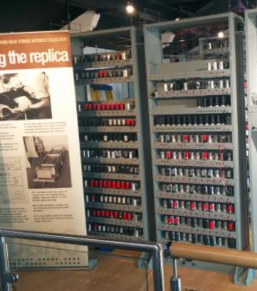
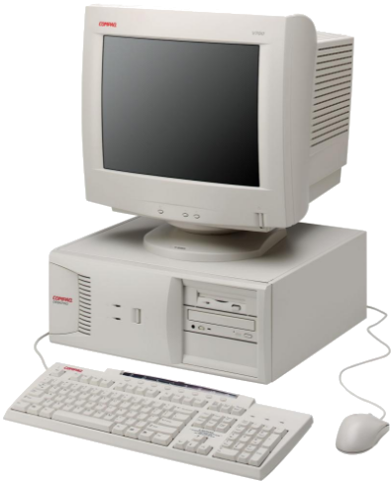
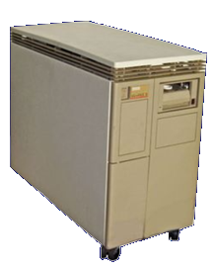
Computer world eco-system model trends
 | EDSAC | mainframe | minicom | IBM PC-AT | workstation (UNIX based) | WNTEL PC | workstation (Linux based)
date | 1950 | 1970 | 1980 | 1985 | 1995 | 1995 | 2000
CPU
Board
OS
App SW
All in one solution
HW vendor can validate
operation as a whole system
(simplified use case)
CPU provider
HW vendor
provide OS
HW vendor
OS vendor
limited 3rd party App → various App)
ISV

Slide 6
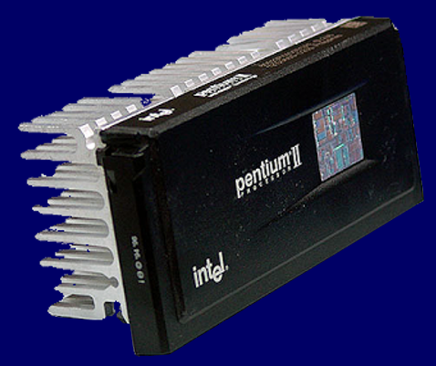
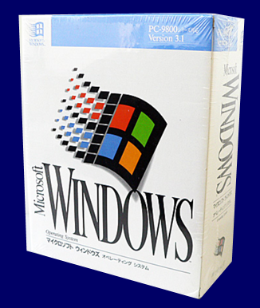
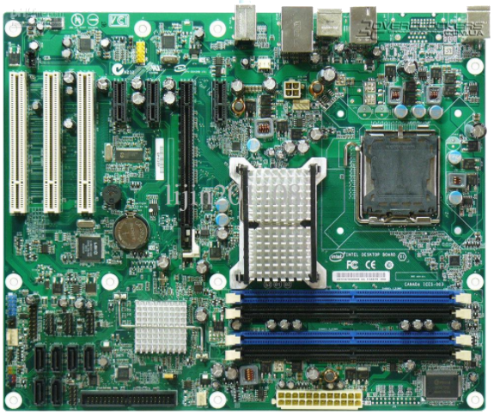
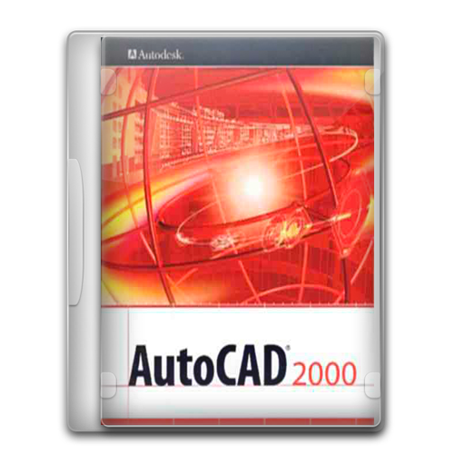
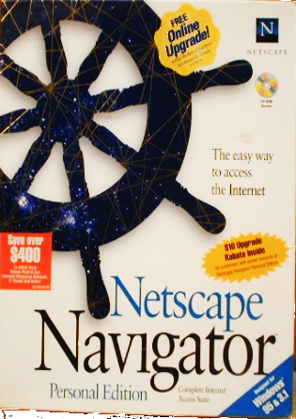
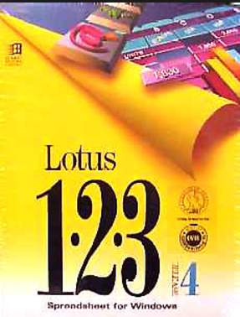
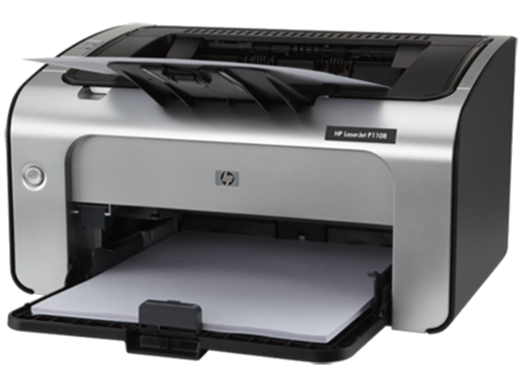
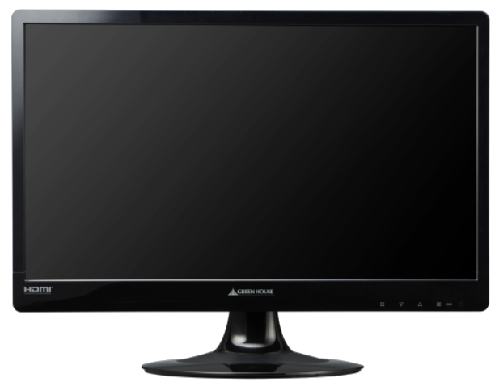
Personal computer (WINTEL model)
Windows 3.1 1990
CPU verification based on OS behavior
WINTEL scheme worked well
IHV
Reference board design by Intel
ISV
3rd party peripherals
3rd party application SW

Slide 7
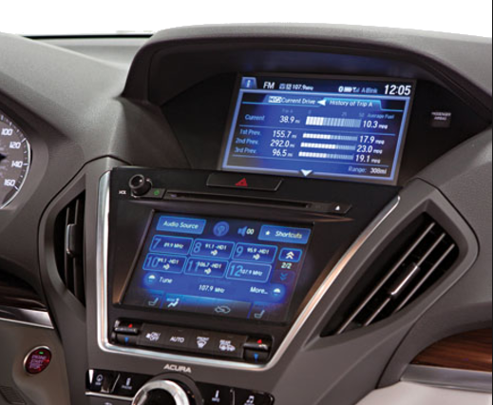
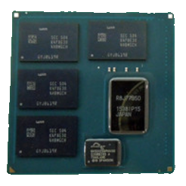

Current IVI system development model
HMI and most of
IVI applications are
privately developed by each tier1
Tier1
supplier
system
board
SOC
OS
Linux BSP
3rd party Middleware
components
IVI
Application
SW
SOC vendor provides base
Linux BSP
media player
map
voice control
connectivity
like WINTEL model,
but as a free delivery
(not fully validated)

Slide 8
Projection of current IVI system
(≈ IT SW state of 20 years ago)
IVI @ 2015～
 | EDSAC | mainframe | minicom | IBM PC-AT | workstation (UNIX based) | WNTEL PC | workstation (Linux based)
date | 1950 | 1970 | 1980 | 1985 | 1995 | 1995 | 2000
CPU
Board
OS
App SW
limited
ISV
All in one solution
HW vendor can validate
operation as a whole system
(use case are limited)
CPU provider
HW vendor
provide OS
HW vendor
OS vendor
limited 3rd party App → various App)
ISV

Slide 9
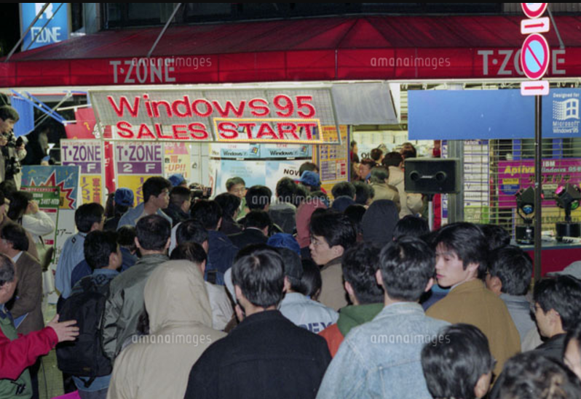
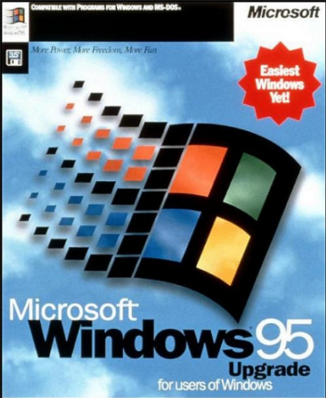
1995 = people start using “connected computer”
23rd Nov 1995 @ mid-night

Slide 10


What IT&PC industry experienced after 1995
Internet connection (from Win95)
Spam, Computer virus (serious after Internet connection)
Software update [e.g. Windows Update] (from Win95)
Portable music player [e.g. iPod] (from 2001)
Virtualization (Xen 2003, KVM 2006)
Cloud (e.g. On-line storage use from 2006)
Smartphone data portability (from 2007)
Web application [e.g. Office365] (from 2011)
SW starts melting
All those technologies are coming to the automotive right now !
connected
car hacking
OTA update
Smartphone connection
Virtualization

Slide 11


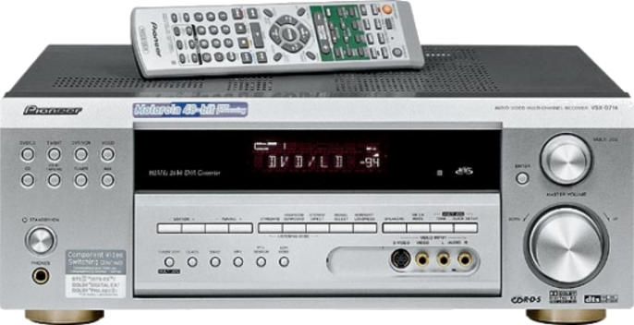






SW provider eco-system model category
 | Generation I | Generation II | Generation III
Target
 | Old age computer Traditional embedded | PC | could IT service connected car
condition | All-in-one delivery | +
HW | Fixed | Fixed | undetermined
SW | Fixed | undetermined | undetermined
Validation | Standalone Test | Certification | Standardization
data portability
IHV
ISV

Slide 12

“Generation I” : validation for all-in-one system
Spec defines all use case combination
You have enough insight for the code
Assumption
problem one
code
size
program code
size is bloating
Quality =
Pass count
All test case
problem two
Quality can indicate by the test coverage.
own
Code visibility
become low
Bug saturation curve
own
others
Accumulative
bug counts
quality
stabilized
point
“Generation I” method no more applicable to IVI due to the complexity and low visibility
time

Slide 13
SW provider eco-system model category
 | Generation I | Generation II | Generation III
Target
 | Old age computer Traditional embedded | PC | could IT service connected car
condition | All-in-one delivery | +
HW | Fixed | Fixed | undetermined
SW | Fixed | undetermined | undetermined
Validation | Standalone Test | Certification | Standardization
data portability
IHV
ISV

Slide 14
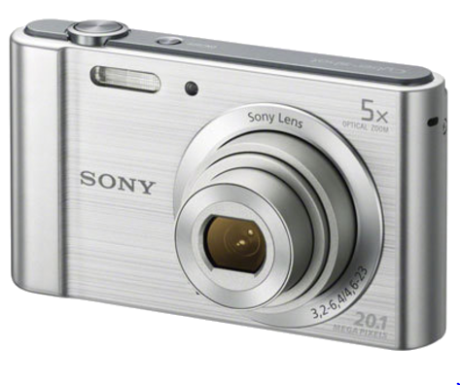
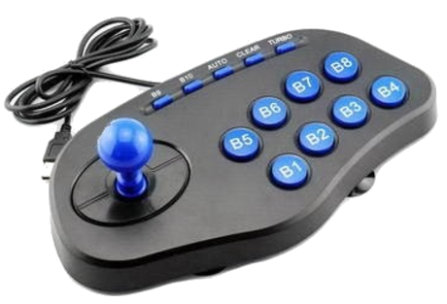


“Generation II” : Compatibility by the certification
hardware interface = industry standards
( USB, PCI, memory BUS, display interface )
relatively clear
Compatibility
Specification
for 3rd party
IHV
very complex
ISV
external software API definition
( vendor specific, include inter-app. coordination )
SW starts melting

Slide 15
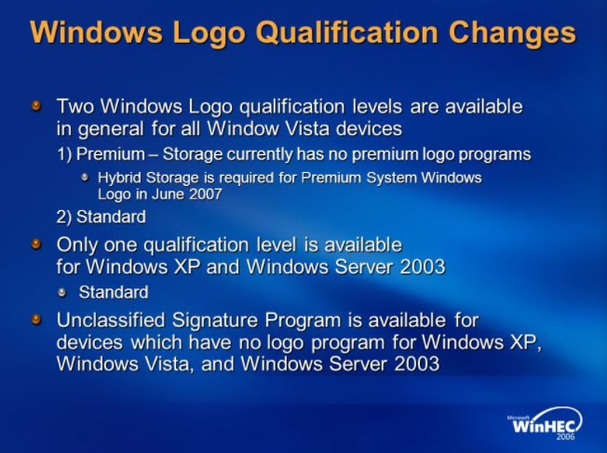
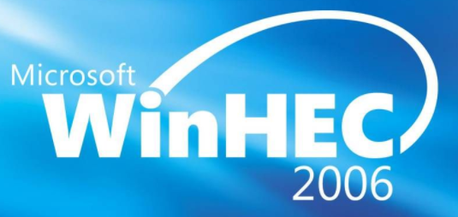
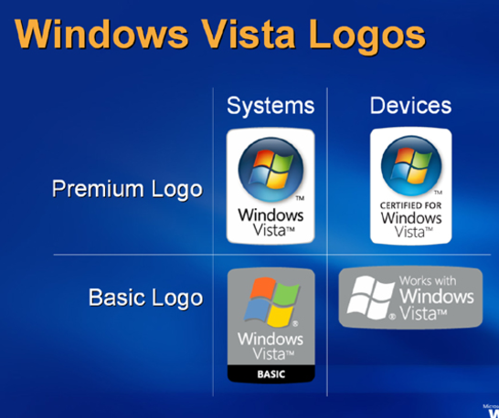
HW Compatibility certification
IHV
HW equipment certification mechanism worked for IHV

Slide 16
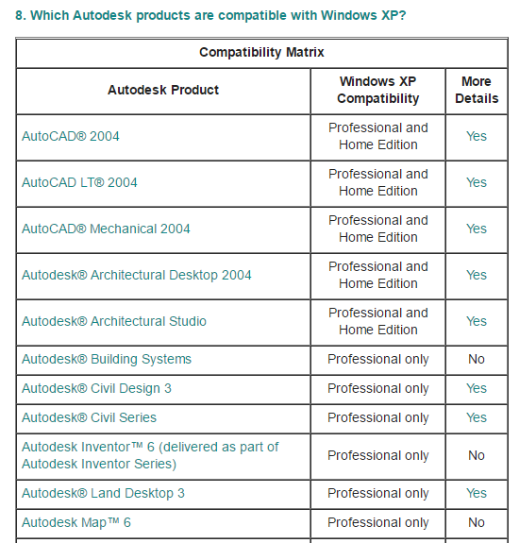
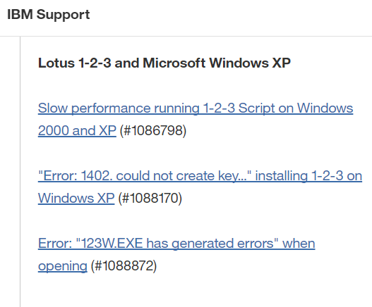
SW Compatibility is more challenge
ISV
http://www-01.ibm.com/support/docview.wss?uid=swg27006485
ISV struggled with quite a lot of compatibility issue (buggy)
http://download.autodesk.com/us/xp_compatibility.htm

Slide 17
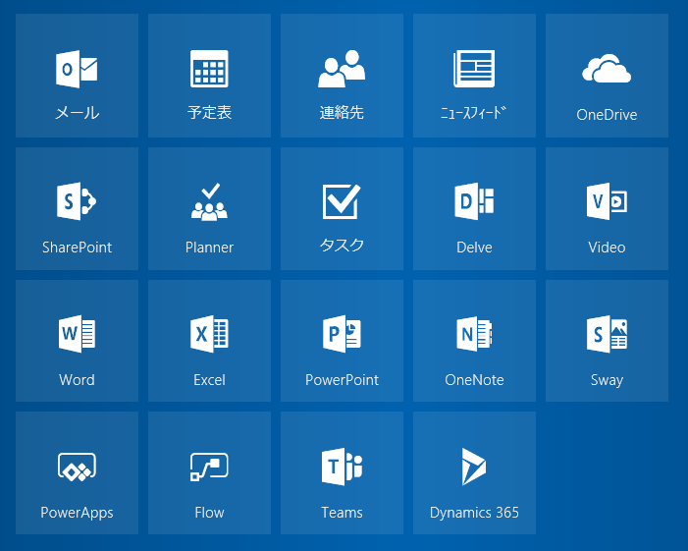


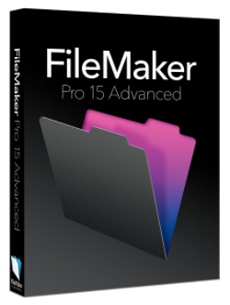


“Microsoft Office” compensated integrity
ISV
major ISV
It looks fallback to the “Generation I” (all-on-one) generation
People start using Microsoft integrated application suites, and that resulted better experience

Slide 18
SW provider eco-system model category
 | Generation I | Generation II | Generation III
Target
 | Old age computer Traditional embedded | PC | could IT service connected car
condition | All-in-one delivery | +
HW | Fixed | Fixed | undetermined
SW | Fixed | undetermined | undetermined
Validation | Standalone Test | Certification | Standardization
data portability
IHV
ISV

Slide 19

“Gen. III” essentially differs from “Gen. II”
Generation II = “Equipment driven” eco-system
Digitalization by
Generation III = “Data driven” eco-system
Even both requires :
1) Industry spread eco-system creation
2) Software migration (update) after product shipment

Slide 20





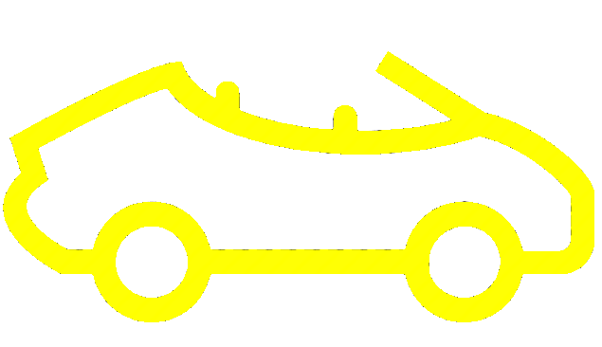








Automotive need to be a part of PC/IT cloud
Smart Phone
Tablet
PC
Wearable
2nd car
Rental Car
Shared Car

Slide 21



Automotive need to be a part of PC/IT cloud
Smart Phone
Tablet
PC
Wearable
security
web
identity
2nd car
Rental Car
Shared Car

Slide 22
Automotive need to be a part of PC/IT cloud
security
web
identity
IT/PC
world
data
vehicle
world
data
seamless
data exchange
via the cloud

Slide 23








Gen. III eco-system realize data driven connected world
application
target hardware
target HW specific
standardization
( for “Gen. II” )
messaging
home (PC)
common
standards
location
automotive
System validation
on cross-industry
common standards
multi media
mobile

Slide 24
Automotive industry should jump to “Generation III”
 | Generation I | Generation II | Generation III
Target
 | Traditional embedded development model | Target Specific eco-system creation | industry-width open data exchange
condition | All-in-one delivery | +
data portability
IHV
ISV
We need to manage “long-jump” to reach
“Gen. III” directly from “Gen. I”.
Target

Slide 25
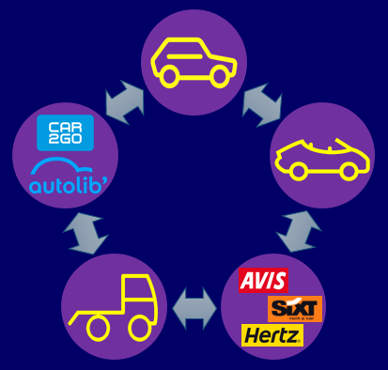




To exceed “Gen. II”, we should learn from PC experience
problem one
code
size
program code
size is bloating
Gen. II wall .
problem two
Gen I wall.
generation II
experience
(IT/PC)
We are lucky, as we can learn a lot from PC/IT industry member

Slide 26
My message summary
At home and office, people already get connected after 1995. And that waves finally reached to the vehicle environment.
IVI system development remains in old age “All-in-one” model. To realize “connected”, we need to migrate to the “open and collaborative” industry-width eco-system.
Traditional equipment oriented eco-system (that PC industry created) does not work for highly complicated modern system. “Data driven brand new eco-system” will solve our issues.
We are lucky as we can learn a lot from PC/IT experience. And
Linux Foundation is the perfect pace to do that.

