Slide 1

Behind the scenes of AGL v3.0
“CC” and towards
Charming Chinook
Hisao Munakata
.
Automotive Grade Linux, Advisory board
Senior Director, Renesas Electronics Corp

Slide 2
Today's topic
Introduction of AGL v3.0 “CC” development (behind the scene)
AGL development process review
Proposal for AGL v4.0 “DD” and later

Slide 3
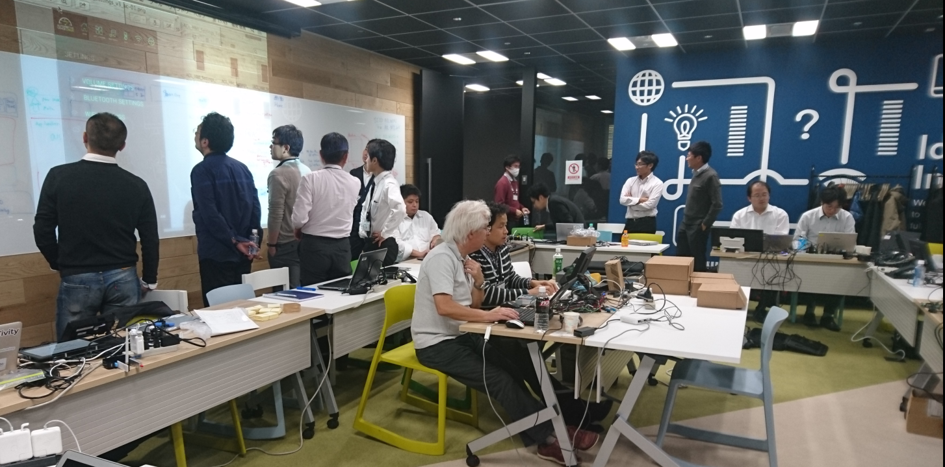
Structural insight of “CC”
Essence of AGL = “working together”
Linux
Foundation
Panasonic
Qt
Toyota
Renesas
Denso
Aisin
AW
NTT Data
MSE
Intel
ALPS
Microchip
Fujitsu
ten
Mentor
Wind
River
AGL CES demo integration WS
2016.11.18-19 @ Yokohama
IoT.bzh
Konsulko
Pioneer
https://wiki.automotivelinux.org/agl-distro/nov2016-f2f
Developers from various member company work together for the single target

Slide 4
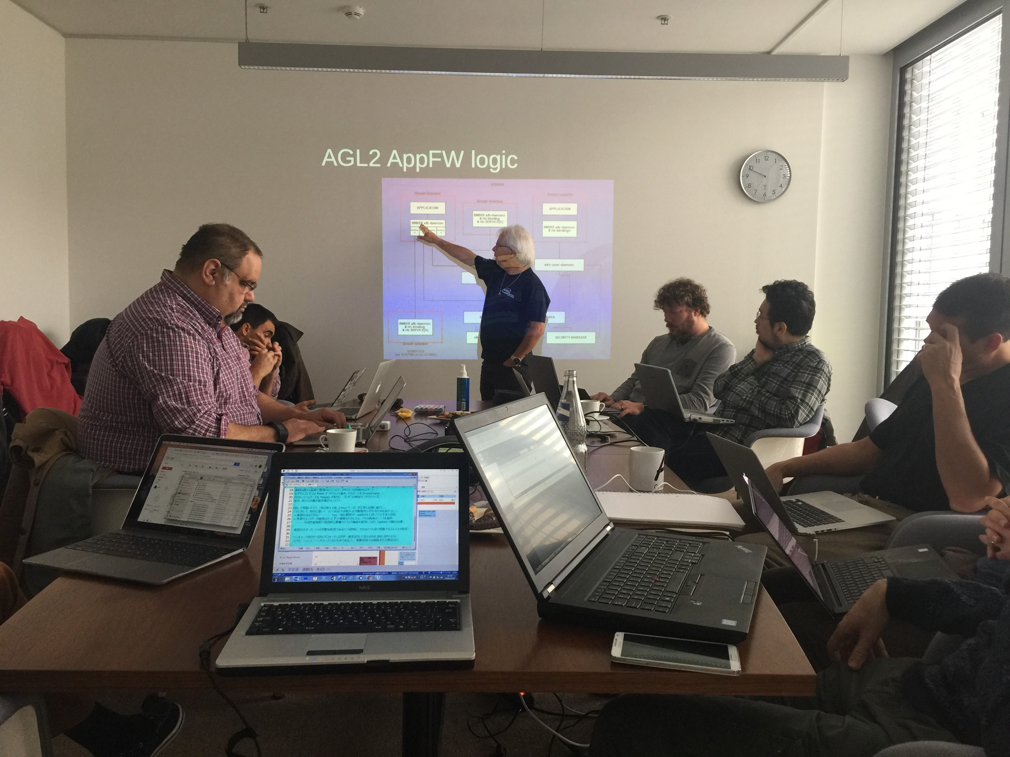
Structural insight of “CC”
Essence of AGL = “working together”
Microchip
Panasonic
Linux
Foundation
Mentor
Intel
Advanced
telematics
Konsulko
Fujitsu
ten
IoT.bzh
AGL Europe F2F meeting
2016.10.14 @ATS Berlin
Renesas
https://wiki.automotivelinux.org/agl-distro/oct2016-f2f

Slide 5
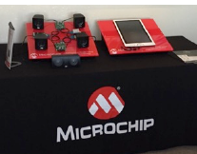
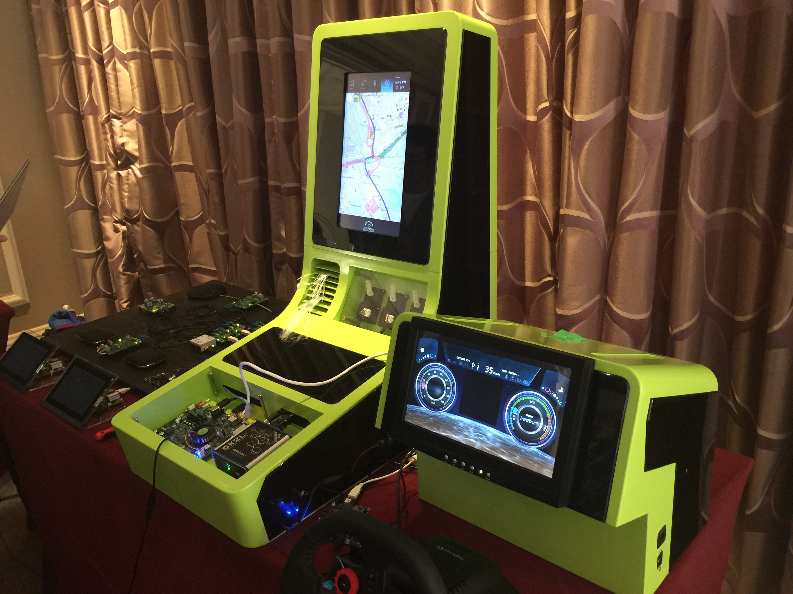
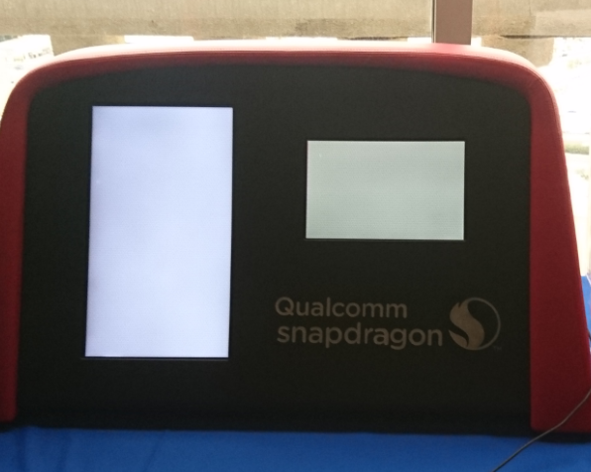
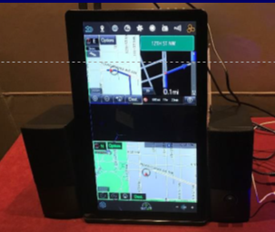
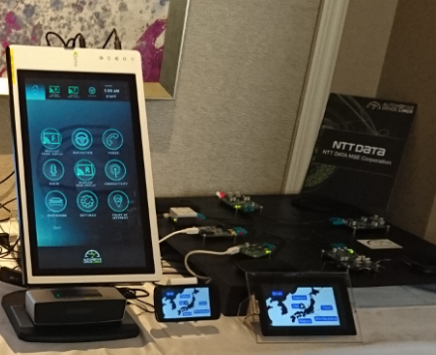
Structural insight of “CC”
AGL v3.0 “CC” unveiled at CES2017
AGL
master
demo
Panaonic
Microchip
+11 demo
Denso
Qualcomm
Aisin AW
NTT Data
MSE
Intel
Texas
Instruments
Advanced
Telematics
Forge
rock
Renesas

Slide 6
Structural insight of “CC”
AGL roadmap : every 6 month update
ver. | AGL 1.0 “Agile Albacore” | AGL 2.0 “Brilliant Blowfish ” | AGL 3.0 “Charming Chinook ”
release | 2015.12.1 | 2016.7.11 | 2017.1.6
demo | 2016 CES | 2016 ALS | 2017 CES
AGL v3.0 Features | UCB updated to use Yocto Project version 2.1 (Krogoth) A brand new home screen and window manager An improved application framework and application launcher A new SDK for rapid application development Reference applications including media player, tuner, navigation, Bluetooth, WiFi, HVAC control, audio mixer, ECU connection and vehicle controls Wide range of hardware board support including Renesas, Qualcomm Technologies, Intel, Texas Instruments, NXP and Raspberry Pi

Slide 7

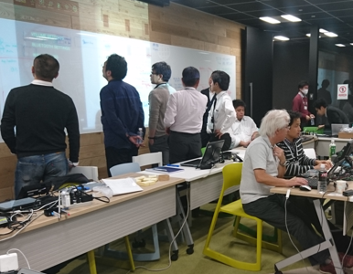
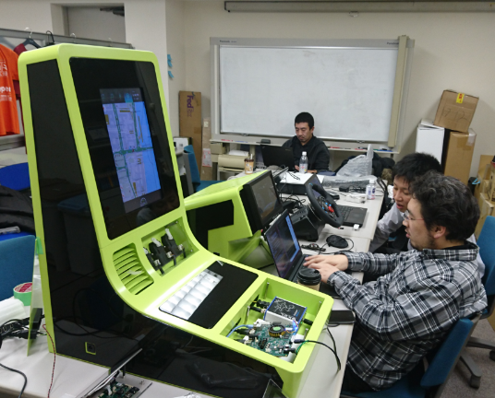
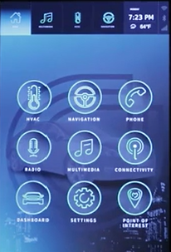
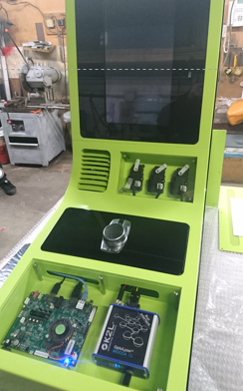
Structural insight of “CC”
Behind the scene of “CC” development
N
= F2F work shop
= Integration & debug
December
number of attendee
November
January
11-13
Renesas
2015
12
2016
9 company
App FW replaced
Qualcomm
Ti
NXP
Raspberry
2016
Intel
Renesas
17-18
14-15
4
28
4-5
39
40
2017
14
25 company
19 company
new home screen
new demo housing
AGL v3.0 “CC” development was much more complicated work than ever

Slide 8

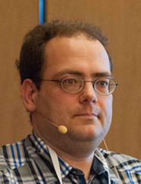


Structural insight of “CC”
Why “CC” development confused a lot?
mainline “CC” code not freeze even at
demo release point
more code contribution
winder SoC target
new feature patch
App
FW
AGL v3.0 mainstream development
refers
Parallel
development
demo only
local patch
AGL CES demonstration integration
Existing AGL demo integration procedure no more works for the new scale

Slide 9


Structural insight of “CC”
Proven reference : Linux kernel development model
code
freeze
Freeze first
Then stabilize
final
release
stabilization period
(6-8 weeks)
reviewed
patch pool
merge
window
(2weeks)
stable
release
RC release
distribution development
Adopt frozen
code for development
early development using under reviewing code
Linux kernel update every around 65 days, following strict patch merge period

Slide 10
AGL development process
AGL “governance” and “developer community”
SAT
= tech. review & proposal
  = development body
  by topic
EG
System
Architecture
Team
Expert
Group
developer
EG
lead
SC
= tech. decision
Steering
Committee
Expert
Group
developer
EG
lead
AB
= finance, resource, direction, event
developer
Advisory
Board
Expert
Group
EG
lead
Governance structure
Developer’s community
developer

Slide 11


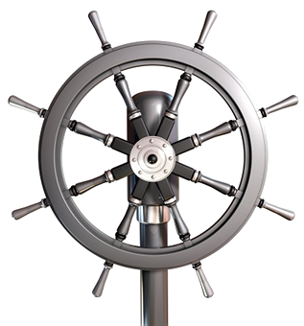
AGL development process
AGL model = transparent community style
proposal
patch
public review
validation
private
ML
pubic
ML
gerrit
Auto
Test
loose control
gate
keeper
AGL
wiki
bug fix
patch
checking a sanity
bi-week
dev/EG call
AGL
master
JIRA
AGL
web
Who Steers?
issue tracking
member zone
public zone
developer zone
code first policy

Slide 12

AGL development process
We need a middle man who steers the development
member’s
expectation
proposal
patch
public review
validation
gerrit
Auto
Test
bridge and steer
gate
keeper
bug fix
patch
SC
SAT
AGL
master
architect
bi-week
dev call
AGL
master
JIRA
AB
issue tracking
member zone
developer zone
code first policy

Slide 13
Towards “DD” and future
We need to settle an official review rules
Initially, we do not want to loose a speed and
passion of community style development.
Not all topics (=patch submission) require
audit by SC (& AB). Master architect has a privilege of daily code migrations.
However, if anyone want to add completely
new scheme that affect existing asset and/or
future scope of AGL, it must be escalated to
the SC review through SAT.
We should have crystal clear and fair rules for
the review and decision process.
member’s
expectation
escalation
SC
SAT
AGL
master
architect
AB
member zone

Slide 14
Towards “DD” and future
AGL compliance = abstraction for application portability
install, uninstall, run, pause, resume, stop
AGL application
Require sustainable interface
portability across the platform (SoC)
long-term reusability (multi version)
app. API
delivery
package
lifecycle
A
switchable
B
AGL library
We should keep some
freedom to replace
encapsulated features
AGL
version
migration
C
switchable
D
kernel
1) Solid and sustainable external API for application portability, reusability
2) Flexibility to select OS core mechanism to allow each OEM’s preference

Slide 15
Towards “DD” and future
Example : Google Android “sustainable” SDK
Google replaced
VM runtime to ART
at ver5.0 release.
No impact for App.
Android application
Google provide some sort of App. portability
across some versions.
(2 to 4 generations)
SDK
CTS
Emulator
ART
replaced
Dalvik
Android library
[ API level ]
24 - 25
23
21 – 22
19
[ Android ver. ]
7.0 “Nougat”
6.0 “Marshmallow”
5.0 “Lollipop”
4.0 “KitKat”
kernel
hardware
offload
replaced
on-chip
audio
Definitely we need more long-term, but now Android offers better option

Slide 16
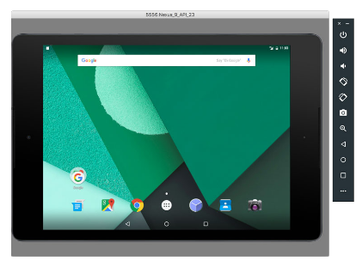
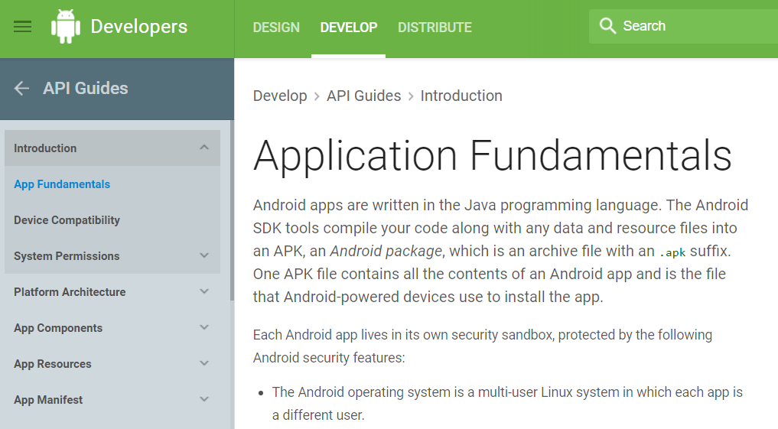
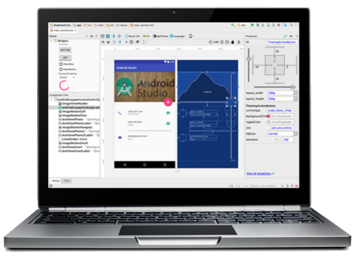
Towards “DD” and future
Example 2 : Android application developer support
emulator runs on PC
on-line document for
Android app. developer
Android studio (IDE)

Slide 17
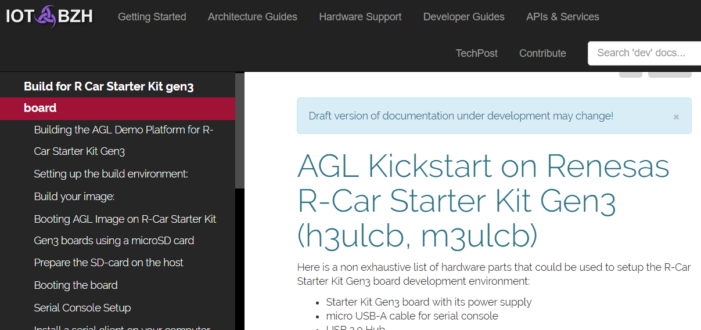
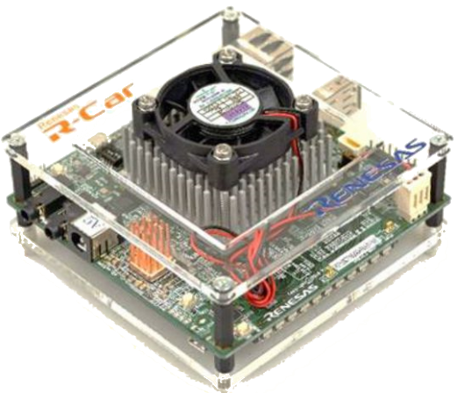
Towards “DD” and future
AGL kick start document : in progress
http://docs.iot.bzh/docs/getting_started/en/dev/reference/machines/R-Car-Starter-Kit-gen3.html
Most of existing AGL
documents, wiki are for BSP developer.
( Not for app. )

Slide 18
Conclusion
AGL community is growing day by day, and existing development model has not been functioning as well as it used to. Due to this, AGL “CC” development was a bit messy; even its result was great, much more than expected.
We need to improve our process and rules to comply with current AGL circumstances. Demo development need to be isolated from upstream development and allocate dedicated maintainer for that.
Community style flexible collaboration and “code first” policy are the beauty of AGL, and we should retain them. At the same time, we need to improve
governance like compliance and technology selection. TBD at SC/AB level.

